Slide 1
Filipino American Christian Church

Slide 2
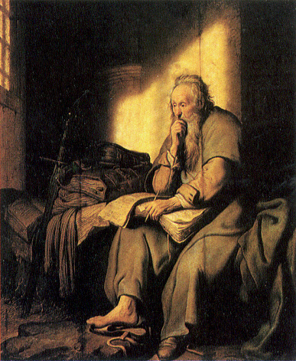
Filipino American Christian Church

Slide 3
Filipino American Christian Church

Slide 4
Across my foundering deck shone
A beacon, an eternal beam. | Flesh fade, and mortal trash
Fall to the residuary worm; | world's wildfire, leave but ash:
In a flash, at a trumpet crash,
I am all at once what Christ is, | since he was what I am, and
This Jack, joke, poor potsherd, | patch, matchwood, immortal diamond,
Is immortal diamond.

Slide 5
Filipino American Christian Church

Slide 7
Filipino American Christian Church

Slide 8
By the Gospel (through Christ), God is accomplishing His great purpose …
and that purpose is to gather for Himself a people; made up of a great multitude of individuals from all across the globe.

Slide 9
Filipino American Christian Church

Slide 10
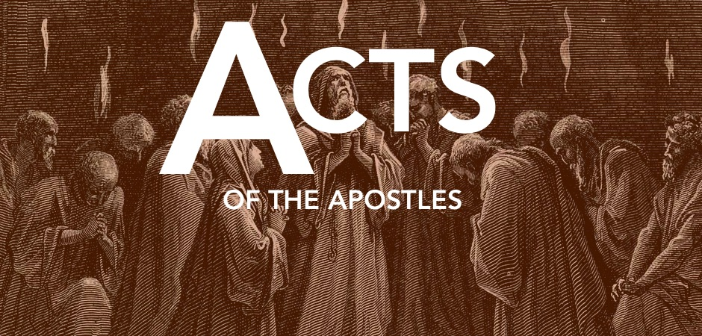
Two Things
First, we can see God’s sovereign orchestration of human history

Slide 11
Filipino American Christian Church

Slide 12
The following night the Lord stood by him and said, “Take courage, for as you have testified to the facts about me in Jerusalem, so you must testify also in Rome.”
-Acts 23:11
And when it was decided that we should sail for Italy …
-Acts 27:1

Slide 13
Acts 27:23-25
“For this very night there stood before me an angel of the God to whom I belong and whom I worship, and he said, ‘Do not be afraid, Paul; you must stand before Caesar. And behold, God has granted you all those who sail with you.’ So take heart, men, for I have faith in God that it will be exactly as I have been told."

Slide 14
Acts 28:23-24, 30-31
When they had appointed a day for him, they came to him at his lodging in greater numbers. From morning till evening he expounded to them, testifying to the kingdom of God and trying to convince them about Jesus both from the Law of Moses and from the Prophets. And some were convinced by what he said …
He lived there two whole years at his own expense, and welcomed all who came to him, proclaiming the kingdom of God and teaching about the Lord Jesus Christ with all boldness and without hindrance.

Slide 15
Filipino American Christian Church

Slide 16
Two Things
First, we can see God’s sovereign orchestration of human history
Second, we see God’s irrepressible Gospel still going forth …

Slide 17
“without hindrance”
akōlytōs

Slide 18
Filipino American Christian Church

Slide 19
Revelation 7:9-12
After this I looked, and behold, a great multitude that no one could number, from every nation, from all tribes and peoples and languages, standing before the throne and before the Lamb, clothed in white robes, with palm branches in their hands, and crying out with a loud voice, “Salvation belongs to our God who sits on the throne, and to the Lamb!” And all the angels were standing around the throne and around the elders and the four living creatures, and they fell on their faces before the throne and worshiped God, saying, “Amen! Blessing and glory and wisdom and thanksgiving and honor and power and might be to our God forever and ever! Amen.”

Slide 20
Filipino American Christian Church

