Slide 1
Filipino American Christian Church

Slide 2
Judges 7:1-8
Then Jerubbaal (that is, Gideon) and all the people who were with him rose early and encamped beside the spring of Harod. And the camp of Midian was north of them, by the hill of Moreh, in the valley.
The Lord said to Gideon, “The people with you are too many for me to give the Midianites into their hand, lest Israel boast over me, saying, ‘My own hand has saved me.’ Now therefore proclaim in the ears of the people, saying, ‘Whoever is fearful and trembling, let him return home and hurry away from Mount Gilead.’” Then 22,000 of the people returned, and 10,000 remained.

Slide 3
Judges 7:1-8
And the Lord said to Gideon, “The people are still too many. Take them down to the water, and I will test them for you there, and anyone of whom I say to you, ‘This one shall go with you,’ shall go with you, and anyone of whom I say to you, ‘This one shall not go with you,’ shall not go.” So he brought the people down to the water. And the Lord said to Gideon, “Every one who laps the water with his tongue, as a dog laps, you shall set by himself. Likewise, every one who kneels down to drink.” And the number of those who lapped, putting their hands to their mouths, was 300 men, but all the rest of the people knelt down to drink water.

Slide 4
Judges 7:1-8
And the Lord said to Gideon, “With the 300 men who lapped I will save you and give the Midianites into your hand, and let all the others go every man to his home.” So the people took provisions in their hands, and their trumpets. And he sent all the rest of Israel every man to his tent, but retained the 300 men. And the camp of Midian was below him in the valley.

Slide 5
Judges 7:16-22
And he divided the 300 men into three companies and put trumpets into the hands of all of them and empty jars, with torches inside the jars. And he said to them, “Look at me, and do likewise. When I come to the outskirts of the camp, do as I do. When I blow the trumpet, I and all who are with me, then blow the trumpets also on every side of all the camp and shout, ‘For the Lord and for Gideon.’”
So Gideon and the hundred men who were with him came to the outskirts of the camp at the beginning of the middle watch, when they had just set the watch. And they blew the trumpets and smashed the jars that were in their hands.

Slide 6
Judges 7:16-22
Then the three companies blew the trumpets and broke the jars. They held in their left hands the torches, and in their right hands the trumpets to blow. And they cried out, “A sword for the Lord and for Gideon!” Every man stood in his place around the camp, and all the army ran. They cried out and fled. When they blew the 300 trumpets, the Lord set every man's sword against his comrade and against all the army. And the army fled as far as Beth-shittah toward Zererah, as far as the border of Abel-meholah, by Tabbath

Slide 7
Filipino American Christian Church

Slide 8
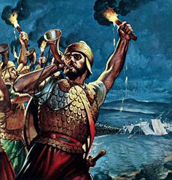
Filipino American Christian Church

Slide 9
Filipino American Christian Church

Slide 10
Judges 5:31
And the land had rest for forty years.

Slide 11
Judges 6:1
The people of Israel did what was evil in the sight of the Lord, and the Lord gave them into the hand of Midian seven years.

Slide 12
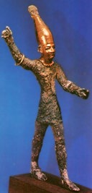
Filipino American Christian Church

Slide 13
Filipino American Christian Church

Slide 14
Judges 6:6, 8-10
6 And Israel was brought very low because of Midian. And the people of Israel cried out for help to the Lord
8 the Lord sent a prophet to the people of Israel. And he said to them, “Thus says the Lord, the God of Israel: I led you up from Egypt and brought you out of the house of slavery. 9 And I delivered you from the hand of the Egyptians and from the hand of all who oppressed you, and drove them out before you and gave you their land. 10 And I said to you, ‘I am the Lord your God; you shall not fear the gods of the Amorites in whose land you dwell.’ But you have not obeyed my voice.”

Slide 15
Judges 6:11-12
Now the angel of the Lord came and sat under the terebinth at Ophrah, which belonged to Joash the Abiezrite, while his son Gideon was beating out wheat in the winepress to hide it from the Midianites. And the angel of the Lord appeared to him and said to him, “The Lord is with you, O mighty man of valor.”

Slide 16
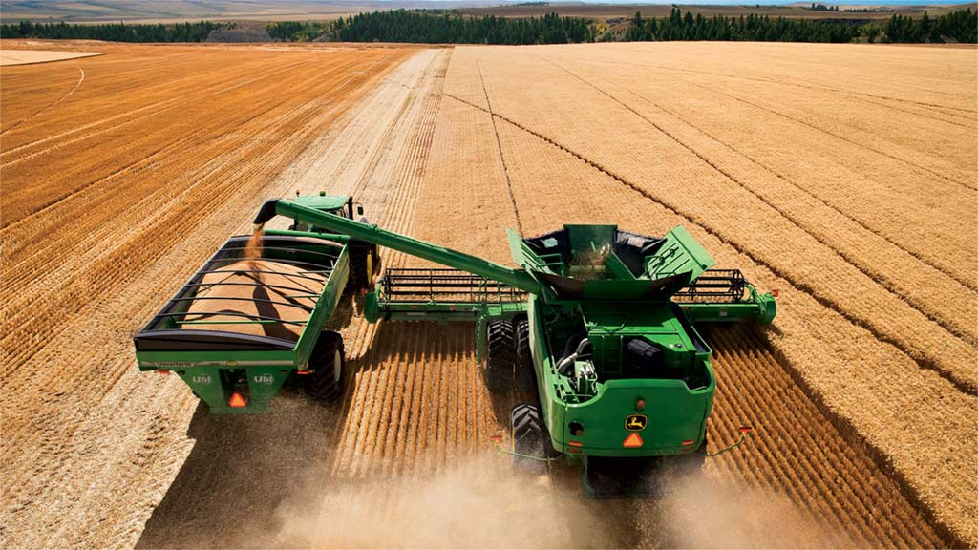
Filipino American Christian Church

Slide 17
Judges 6:13
“Please, my lord, if the Lord is with us, why then has all this happened to us? And where are all his wonderful deeds that our fathers recounted to us, saying, ‘Did not the Lord bring us up from Egypt?’ But now the Lord has forsaken us and given us into the hand of Midian.”

Slide 18
Judges 6:14-15
And the Lord^{[a]} turned to him and said, “Go in this might of yours and save Israel from the hand of Midian; do not I send you?” And he said to him, “Please, Lord, how can I save Israel? Behold, my clan is the weakest in Manasseh, and I am the least in my father's house.”

Slide 19
Filipino American Christian Church

Slide 20
Judges 6:17
And he said to him, “If now I have found favor in your eyes, then show me a sign that it is you who speak with me.”

Slide 21
Filipino American Christian Church

Slide 22
Judges 6:25-27
25 That night the Lord said to him, “Take your father's bull, and the second bull seven years old, and pull down the altar of Baal that your father has, and cut down the Asherah that is beside it 26 and build an altar to the Lord your God.”
27 So Gideon took ten men of his servants and did as the Lord had told him. But because he was too afraid of his family and the men of the town to do it by day, he did it by night.

Slide 23
Filipino American Christian Church

Slide 24
Judges 6:33-35
Now all the Midianites and the Amalekites and the people of the East came together, and they crossed the Jordan and encamped in the Valley of Jezreel. But the Spirit of the Lord clothed Gideon, and he sounded the trumpet, and the Abiezrites were called out to follow him. And he sent messengers throughout all Manasseh, and they too were called out to follow him. And he sent messengers to Asher, Zebulun, and Naphtali, and they went up to meet them.

Slide 25
Filipino American Christian Church

Slide 26
Judges 6:36
Then Gideon said to God, “If you will save Israel by my hand, as you have said, behold, I am laying a fleece of wool on the threshing floor. If there is dew on the fleece alone, and it is dry on all the ground, then I shall know that you will save Israel by my hand, as you have said.”

Slide 27
Filipino American Christian Church

Slide 28
1) God alone rescues and saves!

Slide 29
Judges 7:2
The Lord said to Gideon, “The people with you are too many for me to give the Midianites into their hand, lest Israel boast over me, saying, ‘My own hand has saved me.’”

Slide 30
Judges 7:7, 22
7 And the Lord said to Gideon, “With the 300 men who lapped I will save you and give the Midianites into your hand …”
22 When they blew the 300 trumpets, the Lord set every man's sword against his comrade and against all the army.

Slide 31
1) God alone rescues and saves!
2) God is eager to rescue and save!

Slide 32
1) God alone rescues and saves!
2) God is eager to rescue and save!
3) Our weaknesses do not disqualify us from being used by God!

Slide 33
Judges 6:15
And he said to him, “Please, Lord, how can I save Israel? Behold, my clan is the weakest in Manasseh, and I am the least in my father's house.”

Slide 34
Hebrews 11:32
And what more shall I say? For time would fail me to tell of Gideon, Barak, Samson, Jephthah, of David and Samuel and the prophets—who through faith conquered kingdoms, enforced justice, obtained promises, stopped the mouths of lions, quenched the power of fire, escaped the edge of the sword, were made strong out of weakness, became mighty in war, put foreign armies to flight.

Slide 35
1) God alone rescues and saves!
2) God is eager to rescue and save!
3) Our weaknesses do not disqualify us from being used by God!

Slide 36
Filipino American Christian Church

