Slide 1
Filipino American Christian Church

Slide 3
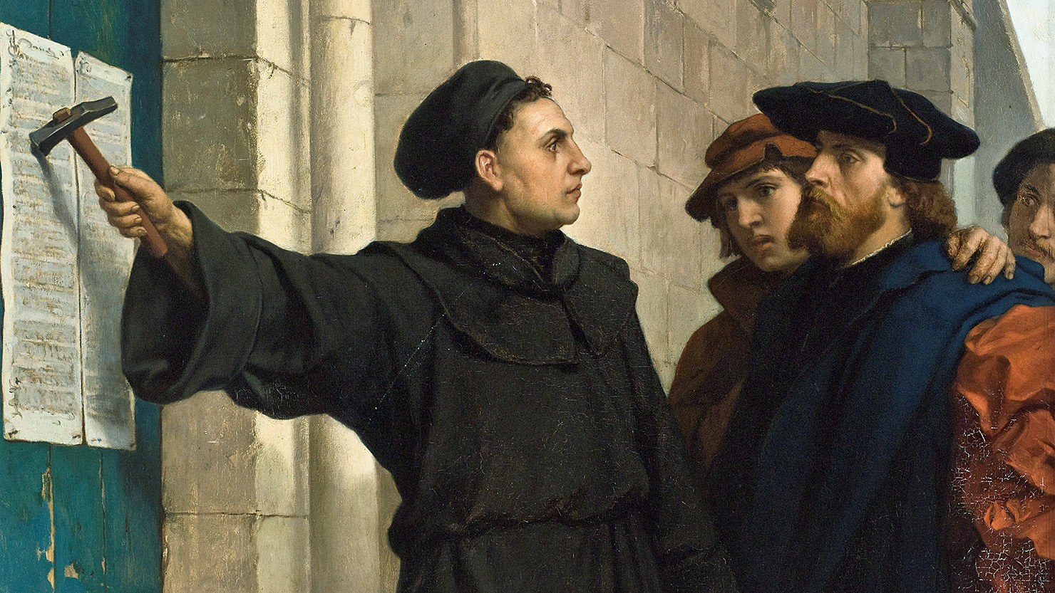

Slide 4
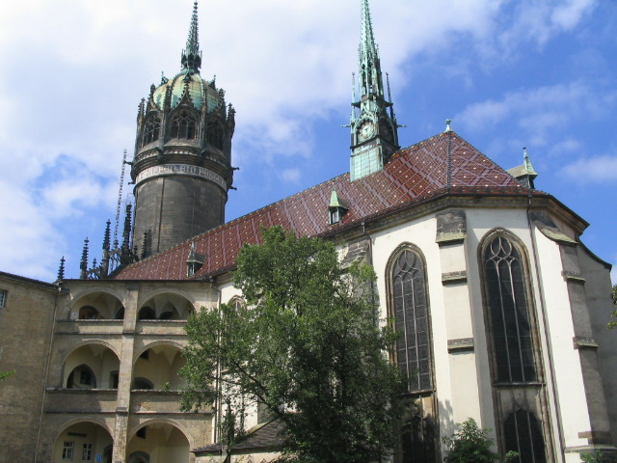

Slide 5
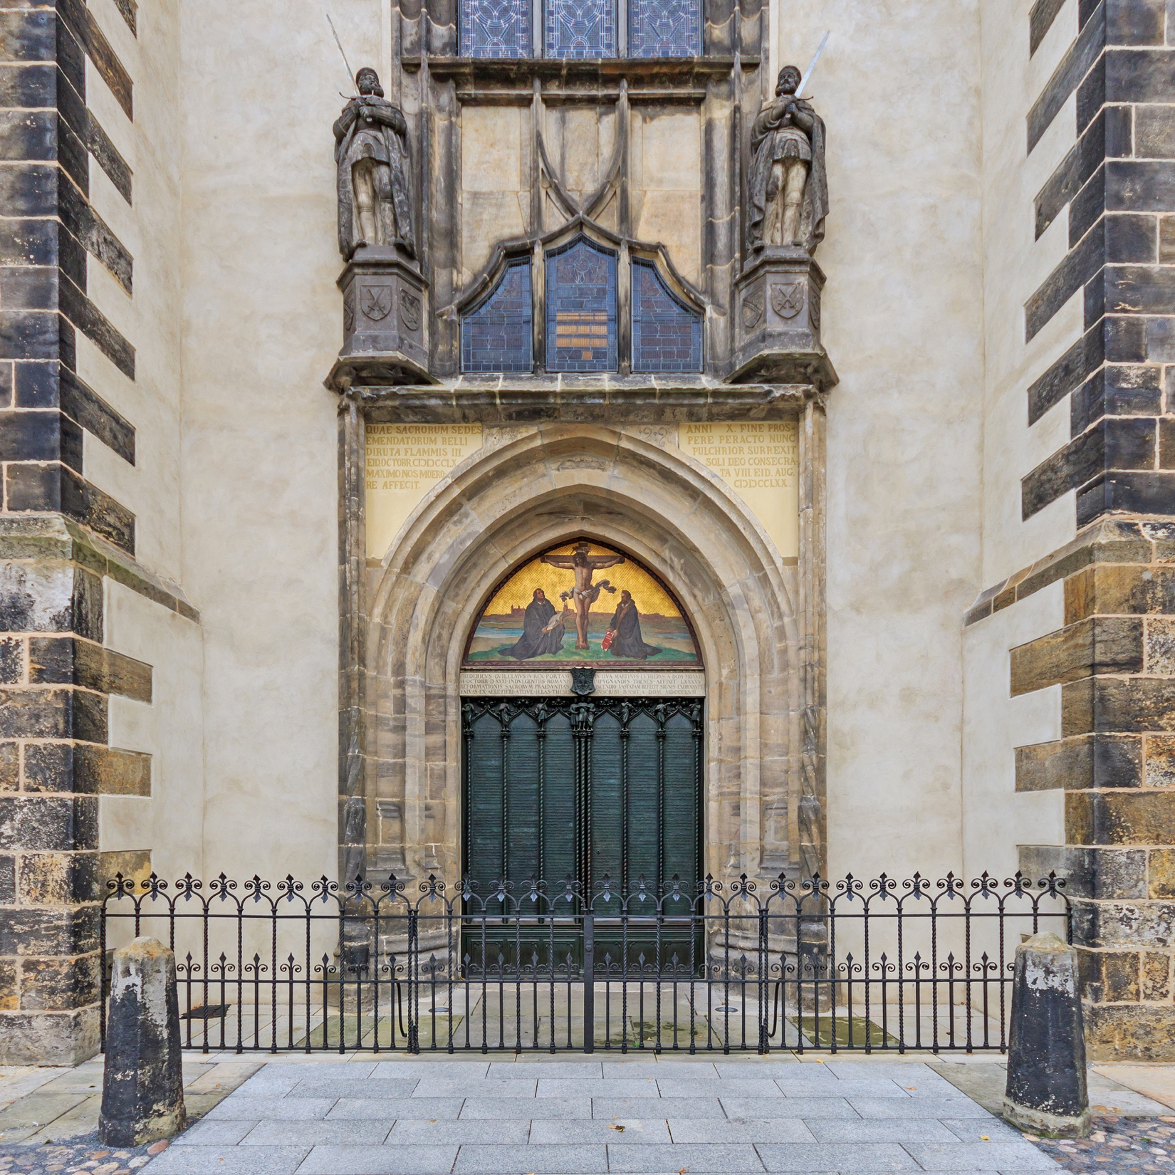

Slide 6
The Five “Solas”
Sola scriptura ("by Scripture alone")
Sola fide ("by faith alone")
Sola gratia ("by grace alone")
Solus Christus or Solo Christo
("Christ alone" or "through Christ alone")
Soli Deo gloria ("glory to God alone")

Slide 8
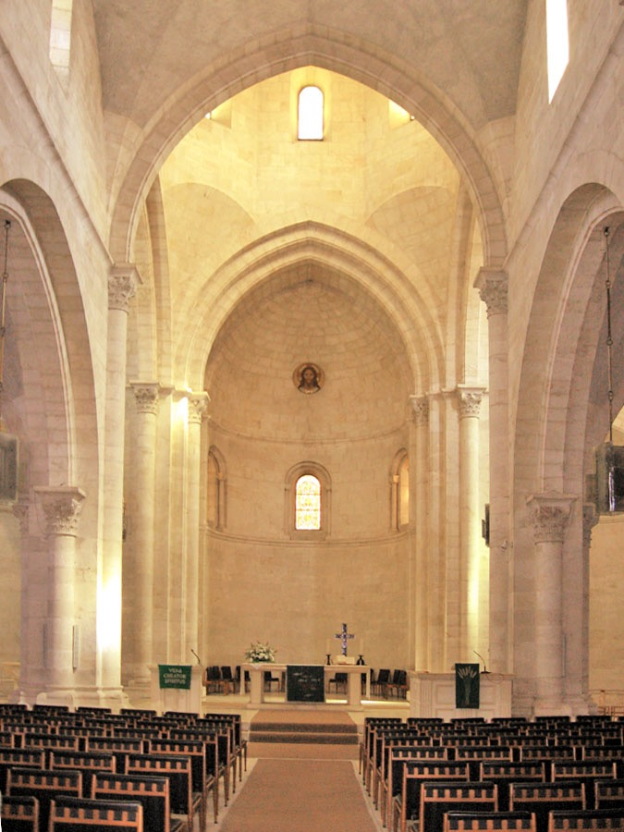
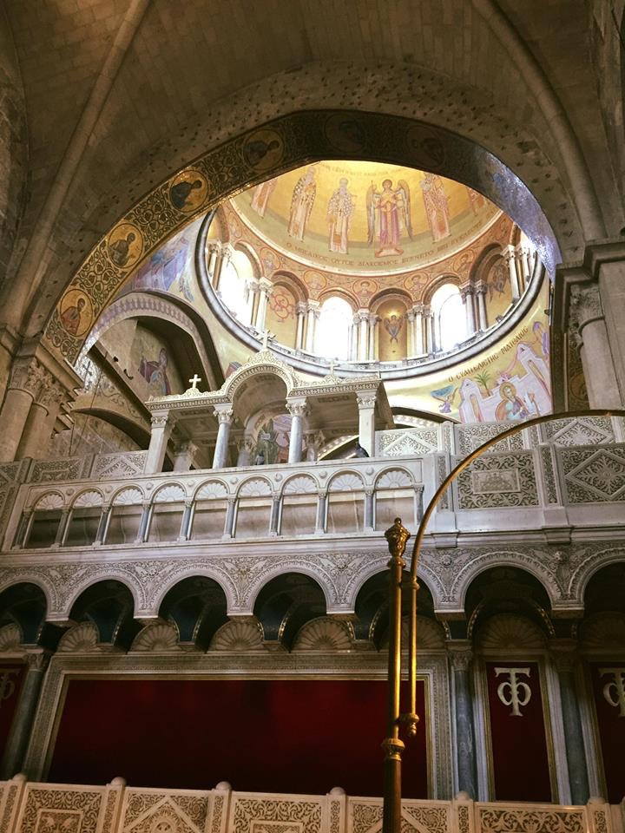

Slide 9
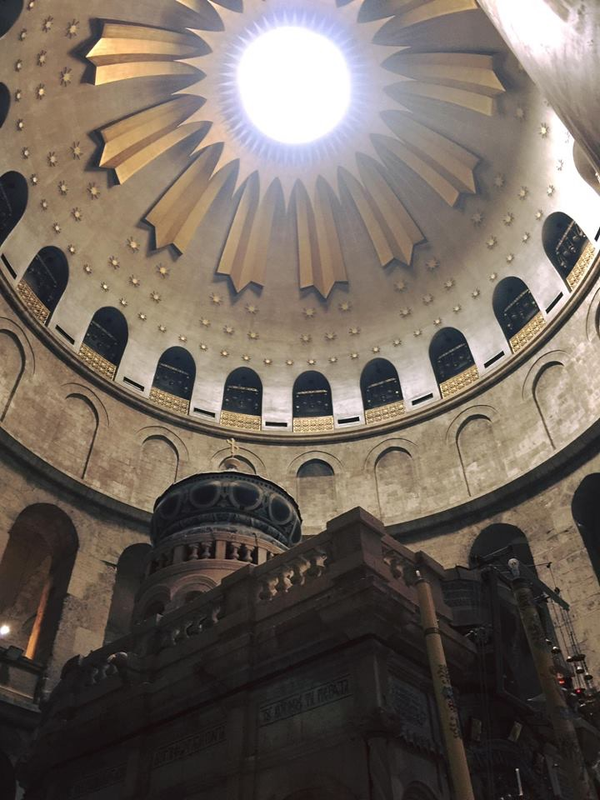

Slide 11
What would you say are your needs in life right now?

Slide 13
acts 2:14-18
But Peter, standing with the eleven, lifted up his voice and addressed them: “Men of Judea and all who dwell in Jerusalem, let this be known to you, and give ear to my words. For these people are not drunk, as you suppose, since it is only the third hour of the day. But this is what was uttered through the prophet Joel: “‘And in the last days it shall be, God declares, that I will pour out my Spirit on all flesh, and your sons and your daughters shall prophesy, and your young men shall see visions, and your old men shall dream dreams; even on my male servants and female servants in those days I will pour out my Spirit, and they shall prophesy.

Slide 15
acts 2:22
Men of Israel, hear these words: Jesus of Nazareth …

Slide 17
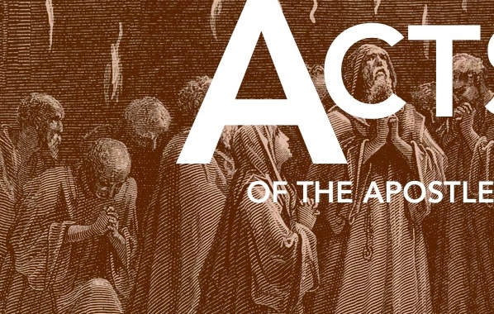
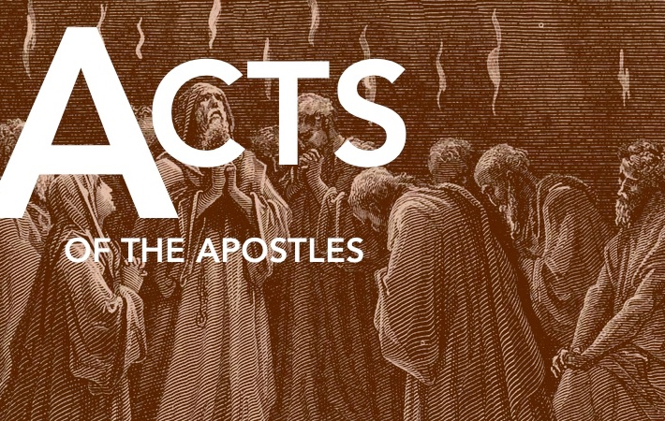
Three Questions:
Who is Jesus?
What did He do?
Why does it matter?

Slide 18
Three Questions:
Who is Jesus?
What did He do?
Why does it matter?

Slide 19
acts 2:22
“Men of Israel, hear these words: Jesus of Nazareth, a man attested to you by God …”

Slide 20
acts 2:24
“God raised him up, loosing the pangs of death, because it was not possible for him to be held by it.”

Slide 21
acts 2:33
“Being therefore exalted at the right hand of God …”

Slide 22
acts 2:36
“Let all the house of Israel therefore know for certain that God has made him both Lord and Christ, this Jesus whom you crucified.”

Slide 23
Three Questions:
Who is Jesus?
What did He do?
Why does it matter?

Slide 24
acts 2:22-24
“Men of Israel, hear these words: Jesus of Nazareth, a man attested to you by God with mighty works and wonders and signs that God did through him in your midst, as you yourselves know— this Jesus, delivered up according to the definite plan and foreknowledge of God, you crucified and killed by the hands of lawless men. God raised him up, loosing the pangs of death, because it was not possible for him to be held by it.

Slide 25
acts 2:25-29
For David says concerning him,
“‘I saw the Lord always before me,
for he is at my right hand that I may not be shaken;
therefore my heart was glad, and my tongue rejoiced;
my flesh also will dwell in hope.
For you will not abandon my soul to Hades,
or let your Holy One see corruption.
You have made known to me the paths of life;
you will make me full of gladness with your presence.’
“Brothers, I may say to you with confidence about the patriarch David that he both died and was buried, and his tomb is with us to this day …”

Slide 26
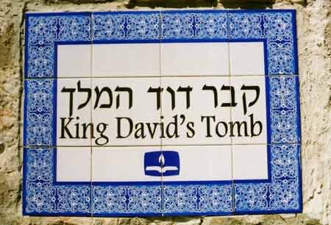

Slide 27
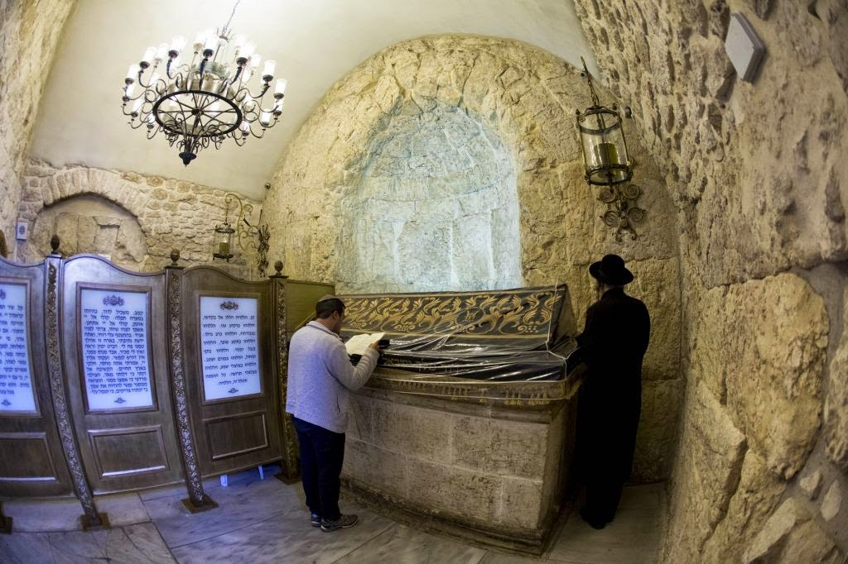

Slide 28
acts 2:30-35
Being therefore a prophet, and knowing that God had sworn with an oath to him that he would set one of his descendants on his throne, he foresaw and spoke about the resurrection of the Christ, that he was not abandoned to Hades, nor did his flesh see corruption. This Jesus God raised up, and of that we all are witnesses. Being therefore exalted at the right hand of God, and having received from the Father the promise of the Holy Spirit, he has poured out this that you yourselves are seeing and hearing. For David did not ascend into the heavens, but he himself says,
“‘The Lord said to my Lord, Sit at my right hand,
until I make your enemies your footstool.”’

Slide 30
acts 2:21
“And it shall come to pass that everyone who calls upon the name of the Lord shall be saved.”

Slide 31
Three Questions:
Who is Jesus?
What did He do?
Why does it matter?

Slide 32
acts 2:37-41
Now when they heard this they were cut to the heart, and said to Peter and the rest of the apostles, “Brothers, what shall we do?” And Peter said to them, “Repent and be baptized every one of you in the name of Jesus Christ for the forgiveness of your sins, and you will receive the gift of the Holy Spirit. For the promise is for you and for your children and for all who are far off, everyone whom the Lord our God calls to himself.” And with many other words he bore witness and continued to exhort them, saying, “Save yourselves from this crooked generation.” So those who received his word were baptized, and there were added that day about three thousand souls.

Slide 34
acts 2:38
“Repent and be baptized every one of you in the name of Jesus Christ for the forgiveness of your sins, and you will receive the gift of the Holy Spirit.”

Slide 36
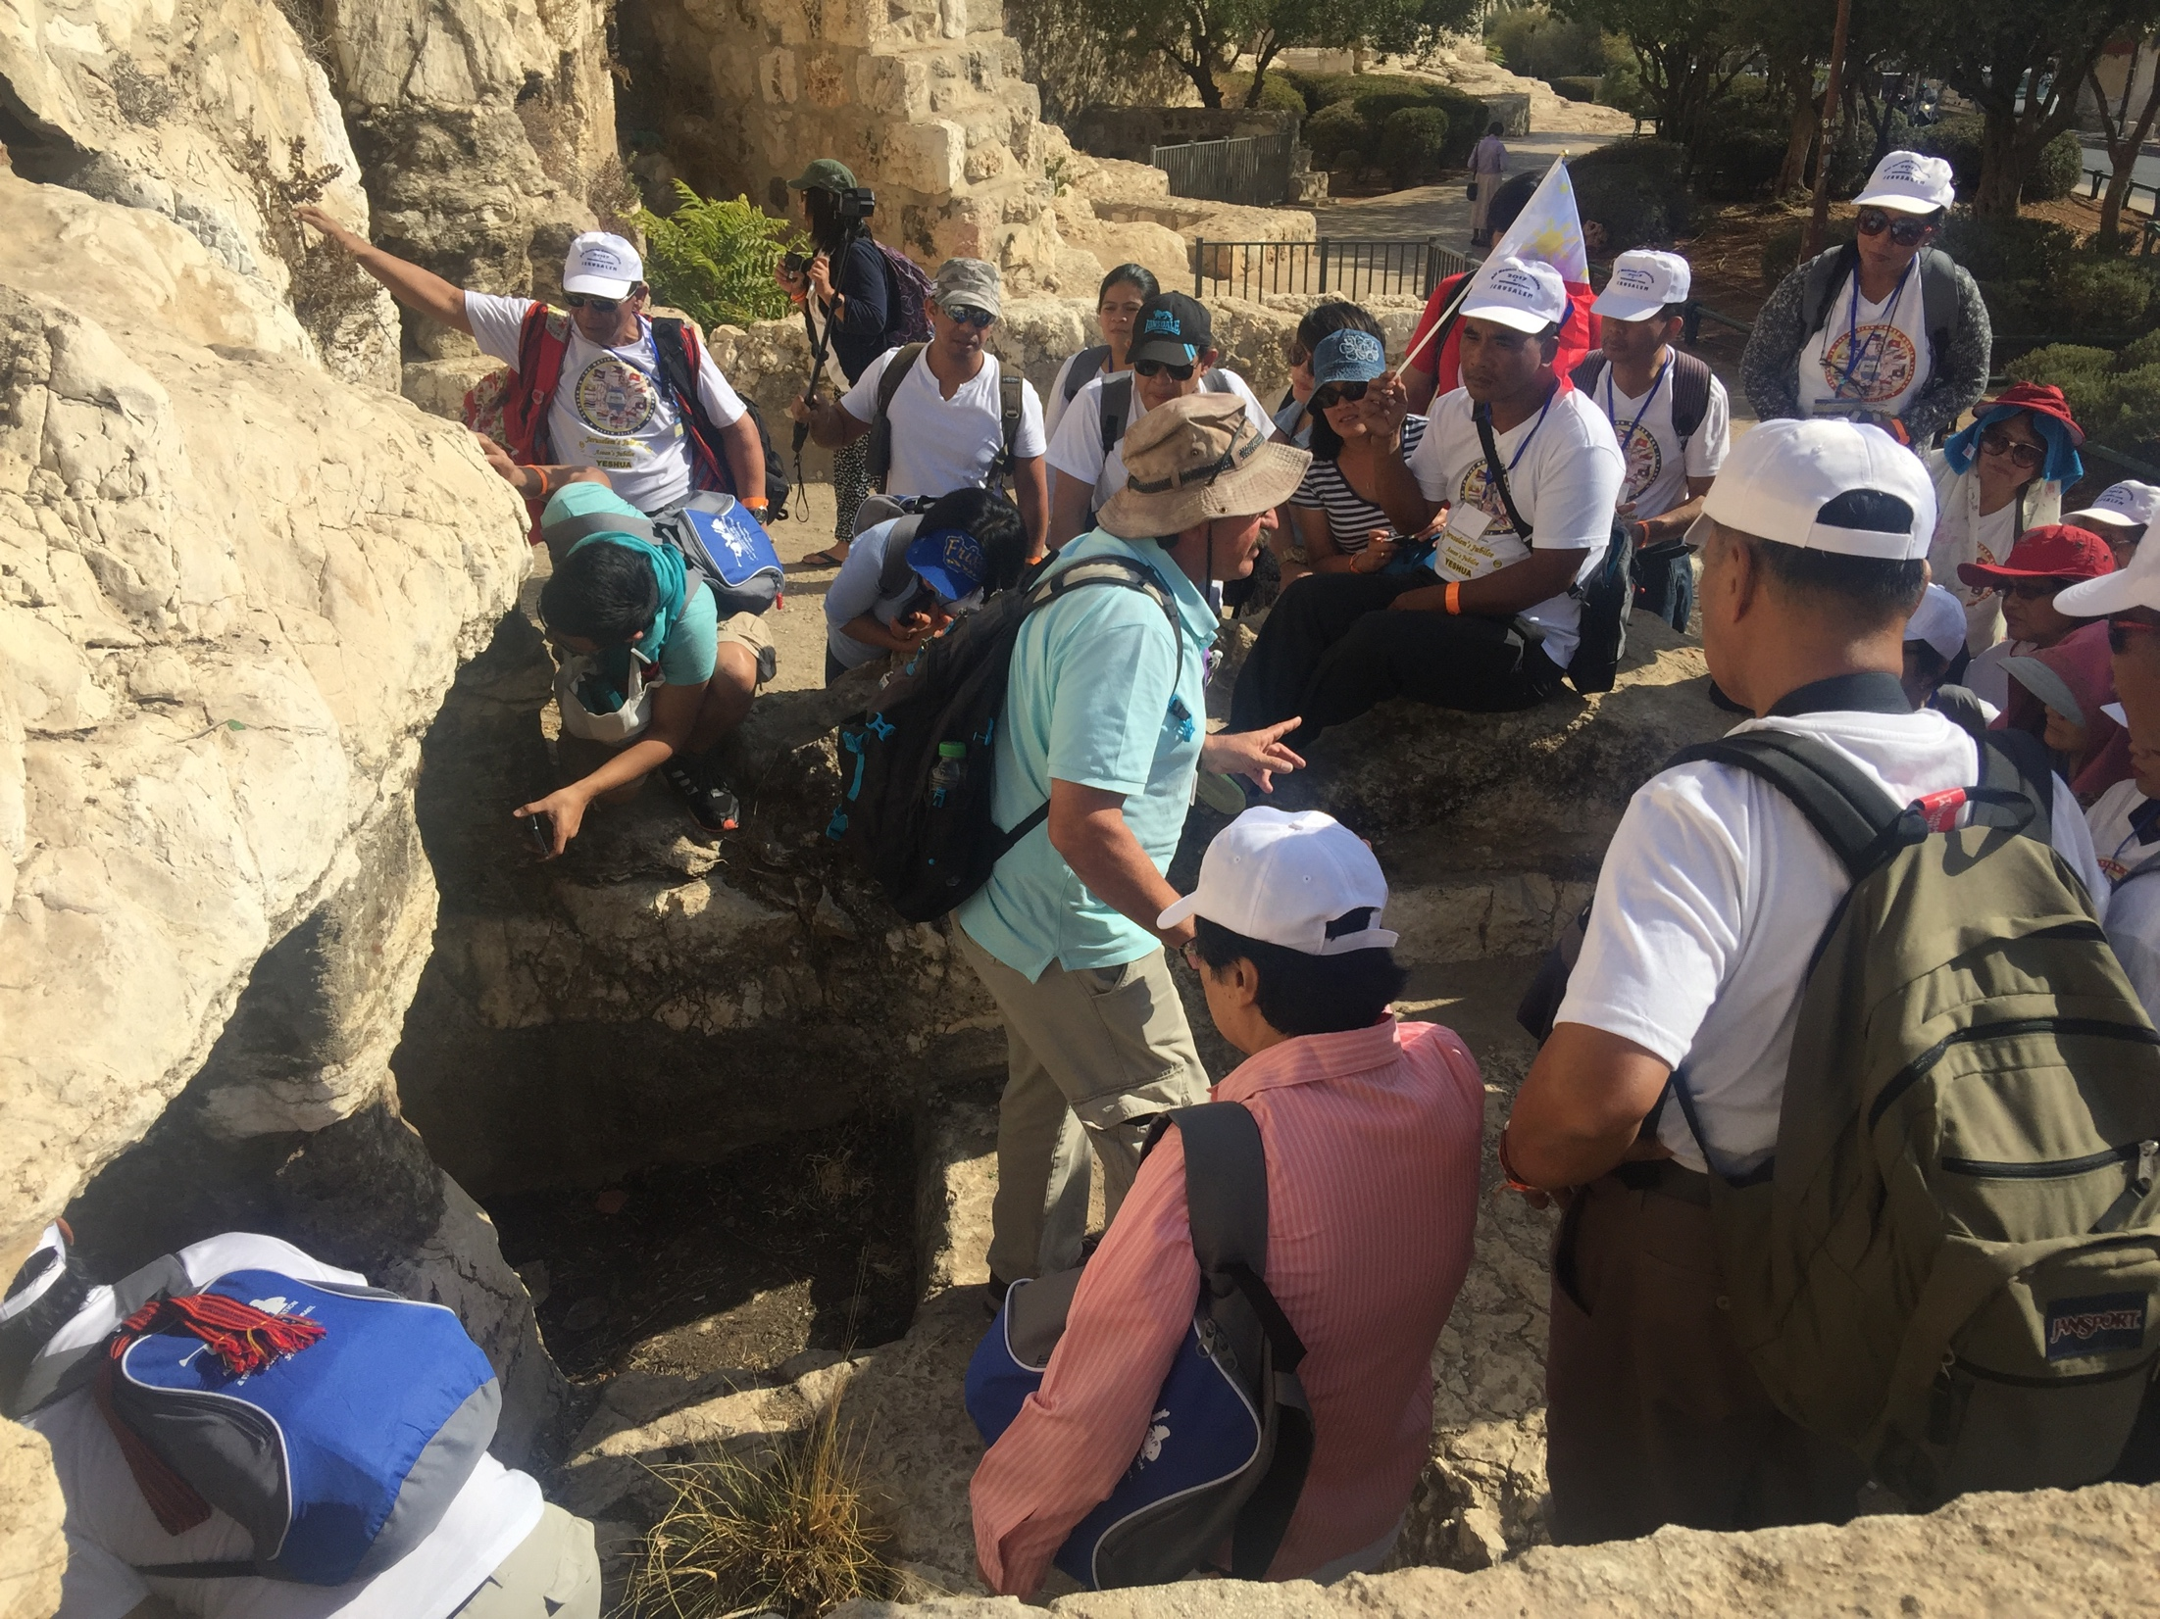

Slide 37
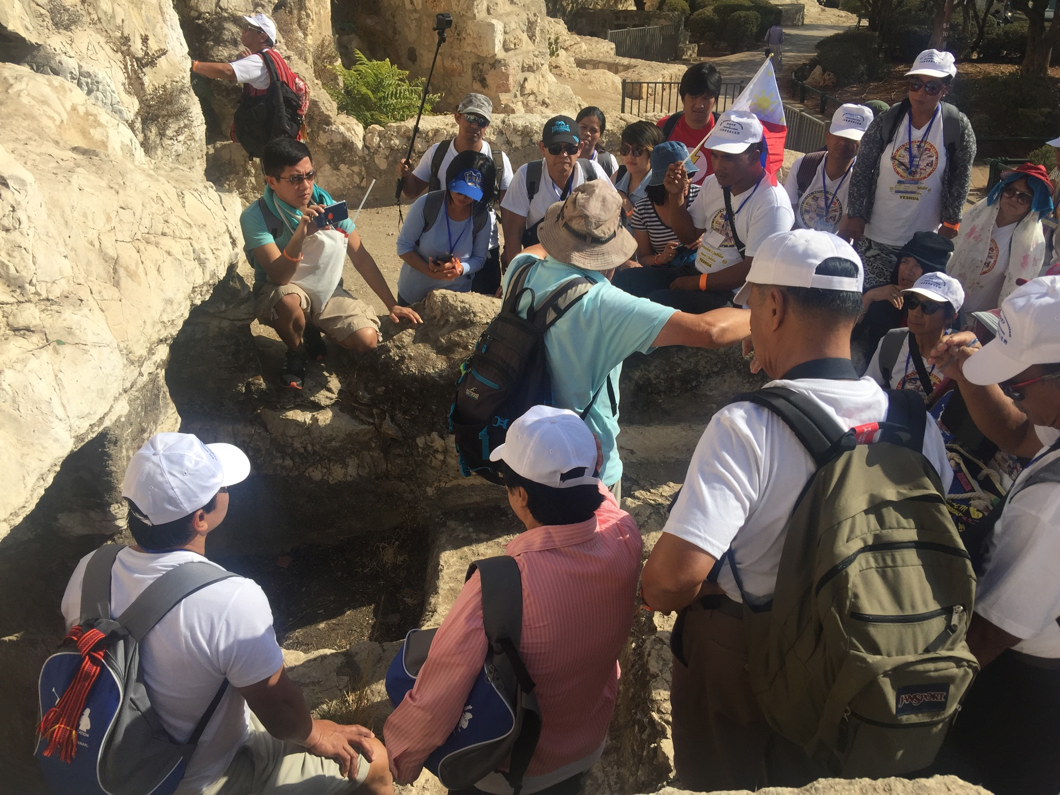

Slide 39
acts 2:40
And with many other words he bore witness and continued to exhort them, saying, “Save yourselves from this crooked generation.”

Slide 40
acts 2:21
“And it shall come to pass that everyone who calls upon the name of the Lord shall be saved.”

Slide 41
Filipino American Christian Church

