Slide 2
Acts 11:19-30
Now those who were scattered because of the persecution that arose over Stephen traveled as far as Phoenicia and Cyprus and Antioch, speaking the word to no one except Jews. But there were some of them, men of Cyprus and Cyrene, who on coming to Antioch spoke to the Hellenists also, preaching the Lord Jesus. And the hand of the Lord was with them, and a great number who believed turned to the Lord. The report of this came to the ears of the church in Jerusalem, and they sent Barnabas to Antioch. When he came and saw the grace of God, he was glad, and he exhorted them all to remain faithful to the Lord with steadfast purpose, for he was a good man

Slide 3
Acts 11:19-30
full of the Holy Spirit and of faith. And a great many people were added to the Lord. So Barnabas went to Tarsus to look for Saul, and when he had found him, he brought him to Antioch. For a whole year they met with the church and taught a great many people. And in Antioch the disciples were first called Christians. Now in these days prophets came down from Jerusalem to Antioch. And one of them named Agabus stood up and foretold by the Spirit that there would be a great famine over all the world (this took place in the days of Claudius). So the disciples determined, every one according to his ability, to send relief to the brothers living in Judea. And they did so, sending it to the elders by the hand of Barnabas and Saul.

Slide 4
Acts 12:25, 13:1-3
And Barnabas and Saul returned from Jerusalem when they had completed their service, bringing with them John, whose other name was Mark (Acts 12:25, ESV).
Now there were in the church at Antioch prophets and teachers, Barnabas, Simeon who was called Niger, Lucius of Cyrene, Manaen a lifelong friend of Herod the tetrarch, and Saul. While they were worshiping the Lord and fasting, the Holy Spirit said, “Set apart for me Barnabas and Saul for the work to which I have called them.” Then after fasting and praying they laid their hands on them and sent them off
(Acts 13:1-3, ESV).

Slide 5
What do you do?

Slide 7
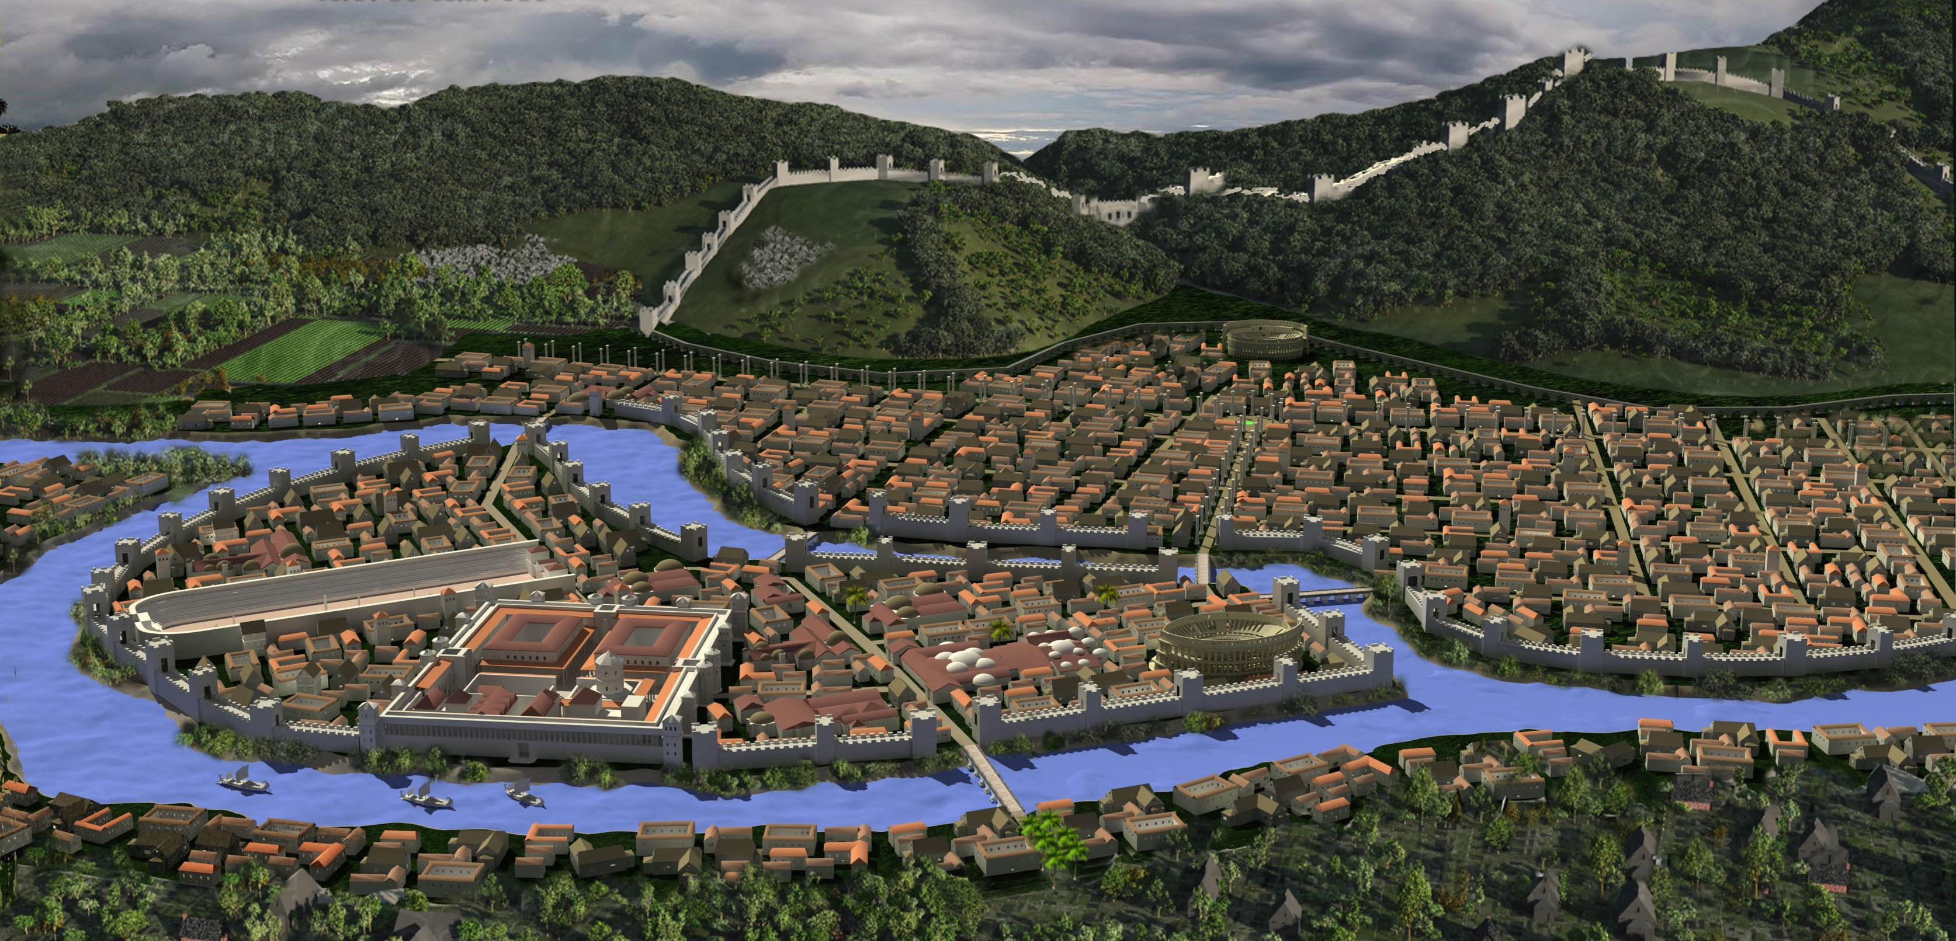

Slide 8
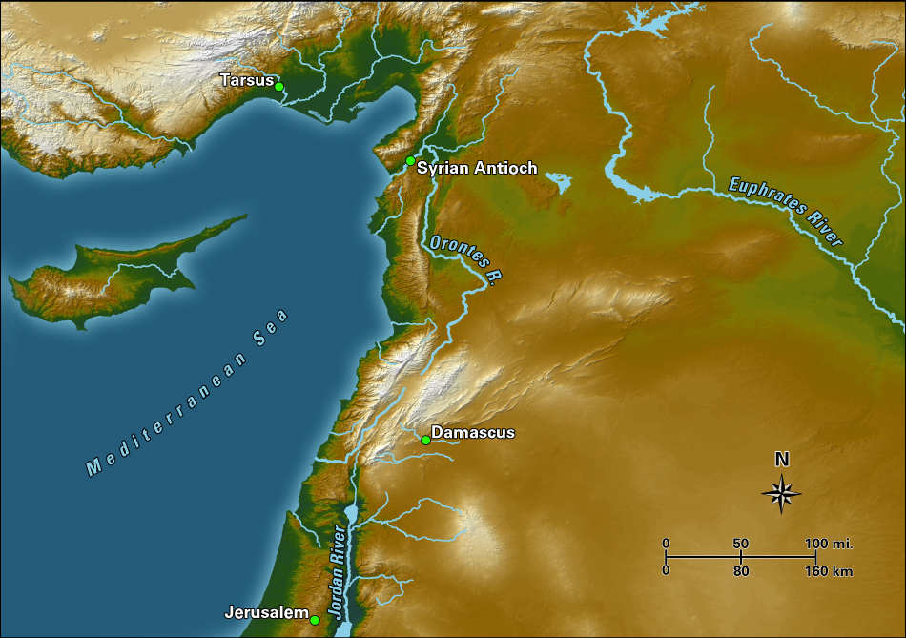

Slide 10
Acts 11:19-21
Now those who were scattered because of the persecution that arose over Stephen traveled as far as Phoenicia and Cyprus and Antioch, speaking the word to no one except Jews. But there were some of them, men of Cyprus and Cyrene, who on coming to Antioch spoke to the Hellenists also, preaching the Lord Jesus. And the hand of the Lord was with them, and a great number who believed turned to the Lord.

Slide 11
—verse 20—
But there were some of them, men of Cyprus and Cyrene, who on coming to Antioch spoke to the Hellenists.
—verse 22—
The report of this came to the ears of the church in Jerusalem, and they sent Barnabas to Antioch.
—verse 25—
So Barnabas went to Tarsus to look for Saul, and when he had found him, he brought him to Antioch.
—verse 27—
Now in these days prophets came down from Jerusalem to Antioch.

Slide 13
Are we committed to this?
Are we committed to the gathering
of the church? Are we committed to the going
of the church?

Slide 15
Acts 11:19-21
Now those who were scattered because of the persecution that arose over Stephen traveled as far as Phoenicia and Cyprus and Antioch, speaking the word to no one except Jews. But there were some of them, men of Cyprus and Cyrene, who on coming to Antioch spoke to the Hellenists also, preaching the Lord Jesus. And the hand of the Lord was with them, and a great number who believed turned to the Lord.

Slide 16
Acts 11:25-26
So Barnabas went to Tarsus to look for Saul, and when he had found him, he brought him to Antioch.

Slide 17
Acts 11:25-26
So Barnabas went to Tarsus to look for Saul, and when he had found him, he brought him to Antioch. For a whole year they met with the church and taught a great many people.

Slide 18
Acts 11:25-26
So Barnabas went to Tarsus to look for Saul, and when he had found him, he brought him to Antioch. For a whole year they met with the church and taught a great many people. And in Antioch the disciples were first called Christians.

Slide 20
We together week by week, we gather:
First, to get our minds and our hearts and our lives formed/shaped by the truth of God together

Slide 21
We together week by week, we gather:
First, to get our minds and our hearts and our lives formed/shaped by the truth of God together
Second, to encourage one another together

Slide 22
We together week by week, we gather:
First, to get our minds and our hearts and our lives formed/shaped by the truth of God together
Second, to encourage one another together
Third, we seize opportunities to serve others together

Slide 23
Acts 11:27-30
Now in these days prophets came down from Jerusalem to Antioch. And one of them named Agabus stood up and foretold by the Spirit that there would be a great famine over all the world (this took place in the days of Claudius). So the disciples determined, every one according to his ability, to send relief to the brothers living in Judea. And they did so, sending it to the elders by the hand of Barnabas and Saul.

Slide 24
We together week by week, we gather:
First, to get our minds and our hearts and our lives formed/shaped by the truth of God together
Second, to encourage one another together
Third, we seize opportunities to serve others together
Fourth, we gather to worship God together

Slide 25
Acts 13:2
While they were worshiping the Lord …

Slide 26
Acts 12:1
I appeal to you therefore, brothers, by the mercies of God, to present your bodies as a living sacrifice,
holy and acceptable to God, which is your spiritual worship …

Slide 28
Acts 13:3
Then after fasting and praying they laid their hands on them and sent them off.

Slide 30
mother goose rhyme
Were walking out one Sunday;
Says Tommy Snooks to Bessie Brooks,
"To-morrow will be Monday."

