Slide 1
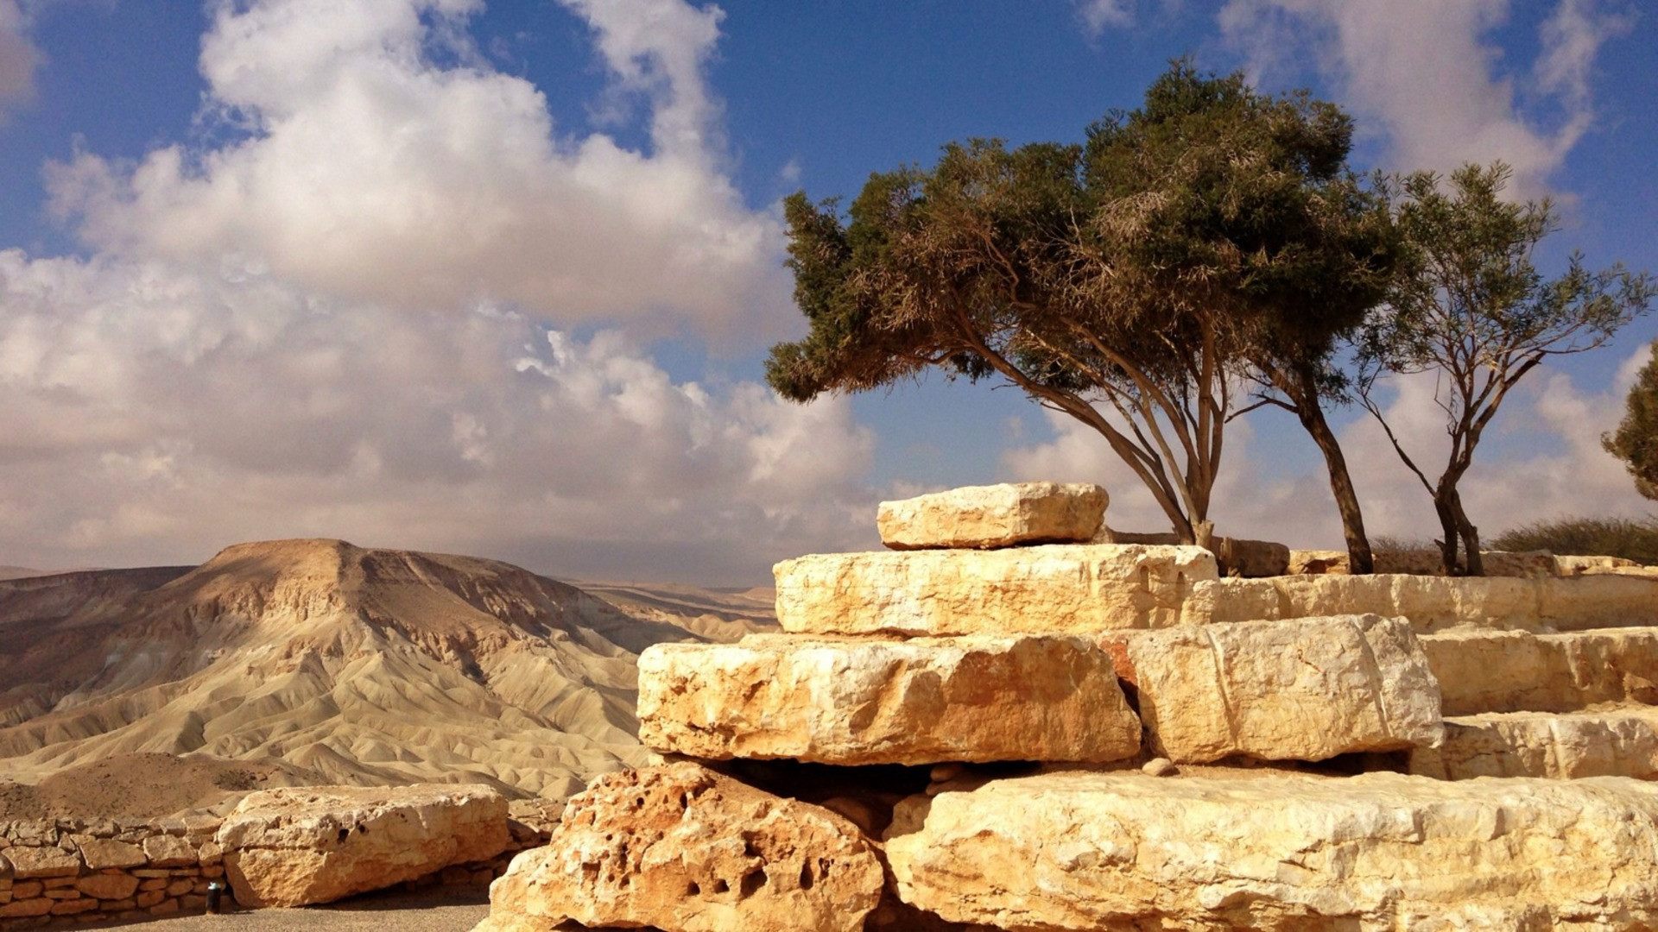
Judges
Filipino American Christian Church

Slide 2
Joshua 23:1-2
A long time afterward, when the Lord had given rest to Israel from all their surrounding enemies, and Joshua was old and well advanced in years, Joshua summoned all Israel, its elders and heads, its judges and officers, and said to them, “I am now old and well advanced in years.”

Slide 3
Joshua 23:9-13
For the Lord has driven out before you great and strong nations. And as for you, no man has been able to stand before you to this day. One man of you puts to flight a thousand, since it is the Lord your God who fights for you, just as he promised you.
Be very careful, therefore, to love the Lord your God. For if you turn back and cling to the remnant of these nations remaining among you and make marriages with them, so that you associate with them and they with you, know for certain that the Lord your God will no longer drive out these nations before you, but they shall be a snare and a trap for you, a whip on your sides and thorns in your eyes, until you perish from off this good ground that the Lord your God has given you.

Slide 4
Judges
Filipino American Christian Church

Slide 5
After the death of Moses …
Joshua 1:1
After the death of Joshua …
Judges 1:1

Slide 6
Judges
Filipino American Christian Church

Slide 7
Judges 1:1-2, 19
1 After the death of Joshua, the people of Israel inquired of the Lord, “Who shall go up first for us against the Canaanites, to fight against them?” 2 The Lord said, “Judah shall go up; behold, I have given the land into his hand.”
19 And the Lord was with Judah, and he took possession of the hill country, but he could not drive out the inhabitants of the plain because they had chariots of iron.

Slide 8
Judges 1:21, 27
21 But the people of Benjamin did not drive out the Jebusites who lived in Jerusalem
27 Manasseh did not drive out the inhabitants of Beth-shean and its villages, or Taanach and its villages, or the inhabitants of Dor and its villages, or the inhabitants of Ibleam and its villages, or the inhabitants of Megiddo and its villages, for the Canaanites persisted in dwelling in that land. 28 When Israel grew strong, they put the Canaanites to forced labor, but did not drive them out completely.

Slide 9
Judges
Filipino American Christian Church

Slide 10
Judges 2:1-5
Now the angel of the Lord went up from Gilgal to Bochim. And he said, “I brought you up from Egypt and brought you into the land that I swore to give to your fathers. I said, ‘I will never break my covenant with you, and you shall make no covenant with the inhabitants of this land; you shall break down their altars.’ But you have not obeyed my voice. What is this you have done? So now I say, I will not drive them out before you, but they shall become thorns in your sides, and their gods shall be a snare to you.” As soon as the angel of the Lord spoke these words to all the people of Israel, the people lifted up their voices and wept. And they called the name of that place Bochim. And they sacrificed there to the Lord.

Slide 11
Judges
Filipino American Christian Church

Slide 12
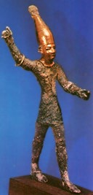
Filipino American Christian Church

Slide 13
Judges
Filipino American Christian Church

Slide 14
What’s God’s purpose in this?
God is passionately committed
to having the undivided devotion of His people …

Slide 15
What’s God’s purpose in this?
God is passionately committed
to having the undivided devotion of His people …
… and He’s accomplishing that through deliverers

Slide 16
Judges
Filipino American Christian Church

Slide 17
Judges 3:7-11
And the people of Israel did what was evil in the sight of the Lord. They forgot the Lord their God and served the Baals and the Asheroth. Therefore the anger of the Lord was kindled against Israel, and he sold them into the hand of Cushan-rishathaim king of Mesopotamia. And the people of Israel served Cushan-rishathaim eight years. But when the people of Israel cried out to the Lord, the Lord raised up a deliverer for the people of Israel, who saved them, Othniel the son of Kenaz, Caleb's younger brother. The Spirit of the Lord was upon him, and he judged Israel. He went out to war, and the Lord gave Cushan-rishathaim king of Mesopotamia into his hand. And his hand prevailed over Cushan-rishathaim. So the land had rest forty years. Then Othniel the son of Kenaz died.

Slide 18
Judges
Filipino American Christian Church

Slide 19
Judges 3:12-30
And the people of Israel again did what was evil in the sight of the Lord, and the Lord strengthened Eglon the king of Moab against Israel, because they had done what was evil in the sight of the Lord. He gathered to himself the Ammonites and the Amalekites, and went and defeated Israel. And they took possession of the city of palms. And the people of Israel served Eglon the king of Moab eighteen years. Then the people of Israel cried out to the Lord, and the Lord raised up for them a deliverer, Ehud, the son of Gera, the Benjaminite, a left-handed man. The people of Israel sent tribute by him to Eglon the king of Moab. And Ehud made for himself a sword with two edges, a cubit in length, and he bound it on his right thigh under his clothes.

Slide 20
Judges 3:12-30
And he presented the tribute to Eglon king of Moab. Now Eglon was a very fat man. And when Ehud had finished presenting the tribute, he sent away the people who carried the tribute. But he himself turned back at the idols near Gilgal and said, “I have a secret message for you, O king.” And he commanded, “Silence.” And all his attendants went out from his presence. And Ehud came to him as he was sitting alone in his cool roof chamber. And Ehud said, “I have a message from God for you.” And he arose from his seat. And Ehud reached with his left hand, took the sword from his right thigh, and thrust it into his belly. And the hilt also went in after the blade, and the fat closed over the blade, for he did not pull the sword out of his belly; and the dung came out.

Slide 21
Judges 3:12-30
Then Ehud went out into the porch and closed the doors of the roof chamber behind him and locked them.
When he had gone, the servants came, and when they saw that the doors of the roof chamber were locked, they thought, “Surely he is relieving himself in the closet of the cool chamber.” And they waited till they were embarrassed. But when he still did not open the doors of the roof chamber, they took the key and opened them, and there lay their lord dead on the floor.
Ehud escaped while they delayed, and he passed beyond the idols and escaped to Seirah. When he arrived, he sounded the trumpet in the hill country of Ephraim.

Slide 22
Judges 3:12-30
Then the people of Israel went down with him from the hill country, and he was their leader. And he said to them, “Follow after me, for the Lord has given your enemies the Moabites into your hand.” So they went down after him and seized the fords of the Jordan against the Moabites and did not allow anyone to pass over. And they killed at that time about 10,000 of the Moabites, all strong, able-bodied men; not a man escaped. So Moab was subdued that day under the hand of Israel. And the land had rest for eighty years.

Slide 23
Judges
Filipino American Christian Church

Slide 24
2 Corinthians 5:15
… and he died for all, that those who live
might no longer live for themselves
but for him who for their sake died and was raised.

Slide 25
Judges
Filipino American Christian Church

