Slide 1
The Four Soils
Mark 4:1-20

Slide 2
Again he began to teach beside the sea. And a very large crowd gathered about him, so that he got into a boat and sat in it on the sea, and the whole crowd was beside the sea on the land. 2 And he was teaching them many things in parables, and in his teaching he said to them:
3 “Listen! Behold, a sower went out to sow. 4 And as he sowed, some seed fell along the path, and the birds came and devoured it. 5 Other seed fell on rocky ground, where it did not have much soil, and immediately it sprang up, since it had no depth of soil. 6 And when the sun rose, it was scorched, and since it had no root, it withered away.

Slide 3
7 Other seed fell among thorns, and the thorns grew up and choked it, and it yielded no grain. 8 And other seeds fell into good soil and produced grain, growing up and increasing and yielding thirtyfold and sixtyfold and a hundredfold.” 9 And he said, “He who has ears to hear, let him hear.”
10 And when he was alone, those around him with the twelve asked him about the parables. 11 And he said to them, “To you has been given the secret of the kingdom of God, but for those outside everything is in parables, 12 so that

Slide 4
“‘they may indeed see but not perceive,
and may indeed hear but not understand,
lest they should turn and be forgiven.’”
13 And he said to them, “Do you not understand this parable? How then will you understand all the parables? 14 The sower sows the word. 15 And these are the ones along the path, where the word is sown: when they hear, Satan immediately comes and takes away the word that is sown in them.

Slide 5
16 And these are the ones sown on rocky ground: the ones who, when they hear the word, immediately receive it with joy. 17 And they have no root in themselves, but endure for a while; then, when tribulation or persecution arises on account of the word, immediately they fall away.
18 And others are the ones sown among thorns. They are those who hear the word, 19 but the cares of the world and the deceitfulness of riches and the desires for other things enter in and choke the word, and it proves unfruitful.

Slide 6
20 But those that were sown on the good soil are the ones who hear the word and accept it and bear fruit, thirtyfold and sixtyfold and a hundredfold.”
Mark 4:1-20

Slide 7
I. Background:
Jesus’ Teaching and Preaching Ministry
“Now after John was arrested, Jesus came into Galilee, proclaiming the gospel of God”
Mark 1:14

Slide 8
References to Jesus’ teaching/preaching
1:15, 22, 37-38
2:2, 13
3:1, 3:14

Slide 9
And he appointed twelve (whom he also named apostles) so that they might be with him and he might send them out to preach
(3:14)

Slide 10
“And he was teaching them many things in parables… He did not speak to them without a parable.”
(Mark 4:2, 34)

Slide 11
II. What is a parable?

Slide 12
Parables express an abstract argument by using a concrete narrative which is easily understood.
-Wikipedia

Slide 13
Sowing seed
Cultivating the Soil
How different ground receives seed

Slide 14
“Take heed what you hear; the measure you give will be the measure you get”
(Mark 4:24)
“Take care then how you hear”
(Luke 8:18)

Slide 15
III. Why Jesus taught in Parables

Slide 16
10 And when he was alone, those around him with the twelve asked him about the parables. 11 And he said to them, “To you has been given the secret of the kingdom of God, but for those outside everything is in parables.”
(Mark 4:10-11)

Slide 17
“To you it has been given” (Mk 4:11)
To them it has not been given” (Mt 13:11)

Slide 18
Isaiah 6:8-13
And I heard the voice of the Lord saying, “Whom shall I send, and who will go for us?” Then I said, “Here I am! Send me.” 9 And he said, “Go, and say to this people:
“‘Keep on hearing, but do not understand;
keep on seeing, but do not perceive.’

Slide 19
10 Make the heart of this people dull,
and their ears heavy,
and blind their eyes;
lest they see with their eyes,
and hear with their ears,
and understand with their hearts,
and turn and be healed.”

Slide 20
Then I said, “How long, O Lord?”
And he said:
“Until cities lie waste
without inhabitant,
and houses without people,
and the land is a desolate waste,
12 and the Lord removes people far away,
and the forsaken places are many in the midst of the land.

Slide 21
13 And though a tenth remain in it,
it will be burned again,
like a terebinth or an oak,
whose stump remains
when it is felled.”
The holy seed is its stump.

Slide 22
Jesus is saying Isaiah chapter 6 was only a foreshadowing of Christ himself.

Slide 23
Romans 11:2-7
“God has not rejected his people whom he foreknew. Do you not know what the Scripture says of Elijah, how he appeals to God against Israel?
“Lord, they have killed your prophets, they have demolished your altars, and I alone am left and they seek my life.” But what is God’s reply to him?
“I have kept for myself seven thousand men who have not bowed the knee to Baal.”

Slide 24
So too at the present time there is a remnant, chosen by grace. But if it is by grace, it is no longer on the basis of works; otherwise, grace would no longer be grace.
What then?
Israel failed to obtain what it was seeking. The elect obtained it, but the rest were hardened”

Slide 25
15 For we are the aroma of Christ to God among those who are being saved and among those who are perishing, 16 to one a fragrance from death to death, to the other a fragrance from life to life.
(2 Corinthians 2:15-16)

Slide 26
For good news came to us just as to them, but the message they heard did not benefit them, because it did not meet with faith in the hearers.
(Hebrews 4:2)

Slide 27
He said to them, “Do you not understand this parable? How then will you understand all the parables?”
(Mark 4:13)

Slide 28
IV. What is the Seed?

Slide 29
“The sower sows the word.” (Mark 4:14)
“the word of the kingdom” (Matthew 13:18)

Slide 30
“The time is fulfilled, and the kingdom of God is at hand; repent and believe in the gospel”
(Mark 1:14-15)

Slide 31
Matthew 2:3-6
“Herod the king… assembled all the chief priests and scribes… inquiring where the Christ was to be born. They told him, ‘In Bethlehem of Judea, for so it is written,
“And you, O Bethlehem, in the land of Judah,
are by no means least among the rulers of Judah;
for from you shall come a ruler
who will shepherd my people Israel.”’”

Slide 32
Isaiah 11:1, 10
There shall come forth a shoot from the stump of Jesse, and a branch from his roots shall bear fruit…
In that day the Lord will extend his hand yet a second time to recover the remnant

Slide 33
Mark 12:35, 37
“the scribes say that the Christ is David’s Son…
David calls him Lord, so how is he his son?”
Other scriptures about the Christ:
Genesis 49, Numbers 24, Isaiah 11:1-16, Jeremiah 30 & 33, Ezekiel 34, Daniel 7, Psalms 2, 110

Slide 34
And one of the elders said to me, “Weep no more; behold, the Lion of the tribe of Judah, the Root of David, has conquered, so that he can open the scroll and its seven seals.”
(Revelation 5:5)
“I, Jesus… am the root… of David”
(Revelation 22:16)

Slide 35
What is the Plant?
“Faith comes from hearing”
(Romans 10:17)
What is the Soil?
“For with the heart one believes [faith]”
(Romans 10:10)

Slide 36
V. The Four Soils

Slide 37
The Four Soils…
Path - No Reception
Rocky - Partial Reception
Thorns - Adulterated Reception
Good Soil - Unequivocal Reception

Slide 38
I. Along the Path (vs. 4, 15) No Reception
And these are the ones along the path, where the word is sown: when they hear, Satan immediately comes and takes away the word that is sown in them.

Slide 39
“you seek to kill me because my word finds no place in you… Why do you not understand what I say? It is because you cannot bear to hear my word.” (John 8:37, 43)
men by their unrighteousness suppress the truth. (Romans 1:18)

Slide 40
Acts 7:51-58
“You stiff-necked people, uncircumcised in heart and ears, you always resist the Holy Spirit…
they ground their teeth at him…
they cried out with a loud voice and stopped their ears and rushed together at him...
Then they cast him out of the city and stoned him.”

Slide 41
II. Rocky Ground (vs.5-6, 16-17) Partial Reception
“it did not have much soil, and immediately it sprang up, since it had no depth of soil. 6 And when the sun rose, it was scorched, and since it had no root, it withered away…
the ones who, when they hear the word, immediately receive it with joy. 17 And they have no root in themselves, but endure for a while; then, when tribulation or persecution arises on account of the word, immediately they fall away.

Slide 42
“I am the way, and the truth, and the life. No one comes to the Father except through me.”
“Whoever has seen me has seen the Father.”
(John 14:6, 9)

Slide 43
“No one can come to me unless the Father who sent me draws him. And I will raise him up on the last day…

Slide 44
… When many of his disciples heard it, they said, “This is a hard saying; who can listen to it?” But Jesus, knowing in himself that his disciples were grumbling about this, said to them, “Do you take offense at this?...
“This is why I told you that no one can come to me unless it is granted him by the Father.”
After this many of his disciples turned back and no longer walked with him.”
(from John 6:44, 60-66)

Slide 45
“In that place there will be weeping and gnashing of teeth”
Matthew
8:12, 13:42, 13:50, 22:13, 24:51, 25:30

Slide 46
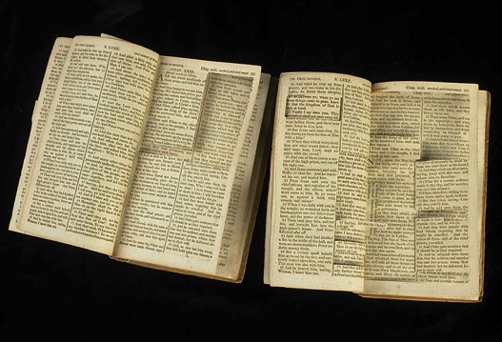
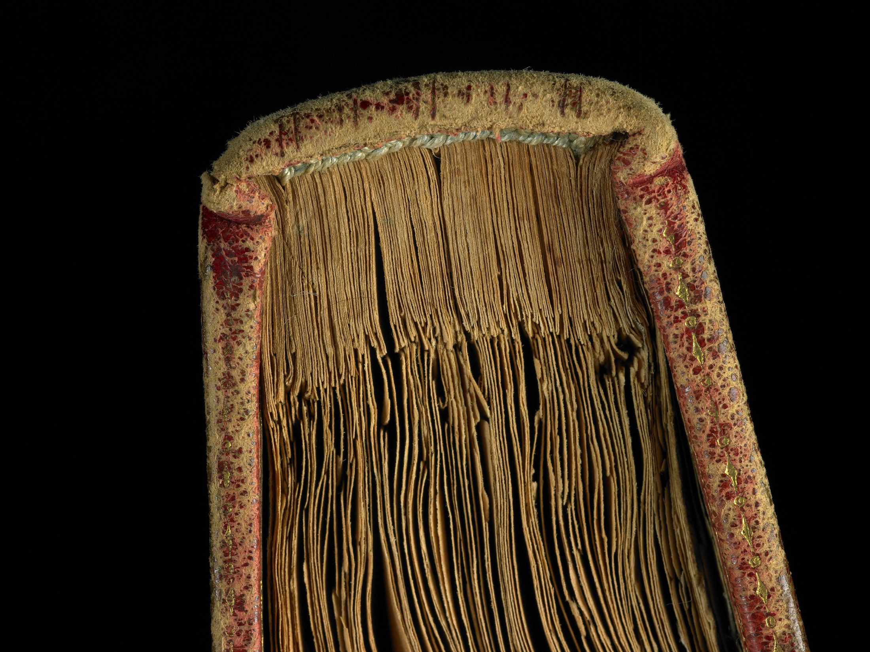
Thomas Jefferson “Bible”

Slide 47
Rocky Ground has ROCKS
2 Corinthians 11:4
For if someone comes and proclaims another Jesus than the one we proclaimed, or if you receive a different spirit from the one you received, or if you accept a different gospel from the one you accepted, you put up with it readily enough.

Slide 48
Galatians 1:6-7; 6:12
I am astonished that you are so quickly deserting him who called you in the grace of Christ and are turning to a different gospel— 7 not that there is another one, but there are some who trouble you and want to distort the gospel of Christ…
12 It is those who want to make a good showing in the flesh who would force you to be circumcised, and only in order that they may not be persecuted for the cross of Christ.

Slide 49
2 Timothy 4:3
For the time is coming when people will not endure sound doctrine, but having itching ears they will accumulate for themselves teachers to suit their own passions
1 John 5:21
Jesus Christ… is the true God and eternal life. Little children, keep yourselves from idols.

Slide 50
III. Thorny Ground (vs. 7, 18-19)
Adulterated Reception
it yielded no grain…
They are those who hear the word, 19 but the cares of the world and the deceitfulness of riches and the desires for other things enter in and choke the word, and it proves unfruitful.
“cares and riches and pleasures of life” (Luke 8:14

Slide 51
1 John 2:15
15 Do not love the world or the things in the world. If anyone loves the world, the love of the Father is not in him.
Galatians 15:17
The desires of the flesh… and the desires of the Spirit… are opposed to each other.
Luke 16:13
You cannot serve God and wealth

Slide 52
James 4:3-4
You ask and do not receive, because you ask wrongly, to spend it on your passions. You adulterous people! Do you not know that friendship with the world is enmity with God? Therefore whoever wishes to be a friend of the world makes himself an enemy of God.

Slide 53
IV. Good Soil (vs. 8, 20) Unequivocal Reception
8 And other seeds fell into good soil and produced grain, growing up and increasing and yielding…
20 But those that were sown on the good soil are the ones who hear the word and accept it and bear fruit, thirtyfold and sixtyfold and a hundredfold.

Slide 54
Luke 3:8,9
Bear fruits in keeping with repentance…Even now the axe is laid to the root of the trees. Every tree therefore that does not bear good fruit is cut down and thrown into the fire.
John 15:6
If anyone does not abide in me he is thrown away like a branch and withers; and the branches are gathered, thrown into the fire, and burned

Slide 55
1. What is the fruit?
Fruit is evidence of saving faith
By this my Father is glorified, that you bear much fruit and so prove to be my disciples.
(John 15:8)

Slide 57
2. But what is the fruit!
15 And these are the ones along the path, where the word is sown: when they hear, Satan immediately comes and takes away the word that is sown in them.
16 And these are the ones sown on rocky ground: the ones who, when they hear the word, immediately receive it with joy. 17 And they have no root in themselves, but endure for a while; then, when tribulation or persecution arises on account of the word, immediately they fall away.
18 And others are the ones sown among thorns. They are those who hear the word, 19 but the cares of the world and the deceitfulness of riches and the desires for other things enter in and choke the word, and it proves unfruitful.

Slide 58
VI. Application
- Accept all of the Word of Christ and trust it
- Study the Word as if your faith depended on it

Slide 62
V. Application

Slide 63
1. Mind the Thorns
Hebrews 11:24-26
By faith Moses, when he was grown up, refused to be called the son of Pharaoh's daughter, choosing rather to be mistreated with the people of God than to enjoy the fleeting pleasures of sin. He considered the reproach of Christ greater wealth than the treasures of Egypt, for he was looking to the reward.
child of Pharoah vs. child of God

Slide 64
1. Mind the Thorns
Only with difficulty will a rich person enter the kingdom of God. (Matthew 19:23)

Slide 65
1 Timothy 6:7, 9-10
We brought nothing into the world, and we cannot take anything out of the world.
9 But those who desire to be rich fall into temptation, into a snare, into many senseless and harmful desires that plunge people into ruin and destruction. 10 For the love of money is a root of all kinds of evils. It is through this craving that some have wandered away from the faith and pierced themselves with many pangs.

Slide 66
1. Mind the Thorns
“I have said all these things to you to keep you from falling away.” (John 16:1)

Slide 67
2. Re-evaluate your perception of “seekers”
90% - Preaching
88% - Doctrine
49% - friendly people
For am I now seeking the approval of man, or of God? Or am I trying to please man? If I were still trying to please man, I would not be a servant of Christ. (Galatians 1:10)

Slide 68
For good news came to us just as to them, but the message they heard did not benefit them, because it did not meet with faith in the hearers.
(Hebrews 4:2)

Slide 69
“Pay attention to what you hear: with the measure you use, it will be measured to you, and still more will be added to you. For to the one who has, more will be given, and from the one who has not, even what he has will be taken away.”
(Mark 4:25)

