Slide 1
Filipino American Christian Church

Slide 2
protoevangelium / Genesis 3:14-15
The Lord God said to the serpent,
“Because you have done this,
cursed are you above all livestock
and above all beasts of the field;
on your belly you shall go,
and dust you shall eat
all the days of your life.
I will put enmity between you and the woman,
and between your offspring and her offspring;
he shall bruise your head,
and you shall bruise his heel.”

Slide 3
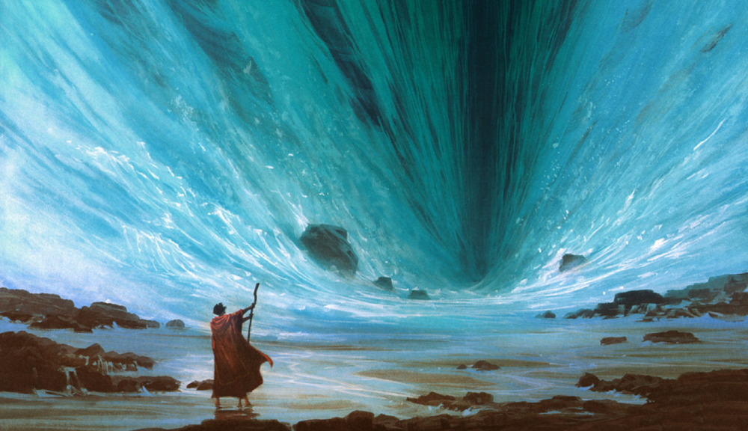

Slide 4
Israel’s special status as the people of God is not an end in itself but rather a means to an end, namely, the fulfillment of God’s universal purpose.

Slide 5
Filipino American Christian Church

Slide 6
Judges 4:6-7
She sent and summoned Barak the son of Abinoam from Kedesh-naphtali and said to him, “Has not the Lord, the God of Israel, commanded you, ‘Go, gather your men at Mount Tabor, taking 10,000 from the people of Naphtali and the people of Zebulun. And I will draw out Sisera, the general of Jabin's army, to meet you by the river Kishon with his chariots and his troops, and I will give him into your hand’?”

Slide 7
Judges 4:9
And she said, “I will surely go with you. Nevertheless, the road on which you are going will not lead to your glory, for the Lord will sell Sisera into the hand of a woman.”

Slide 8
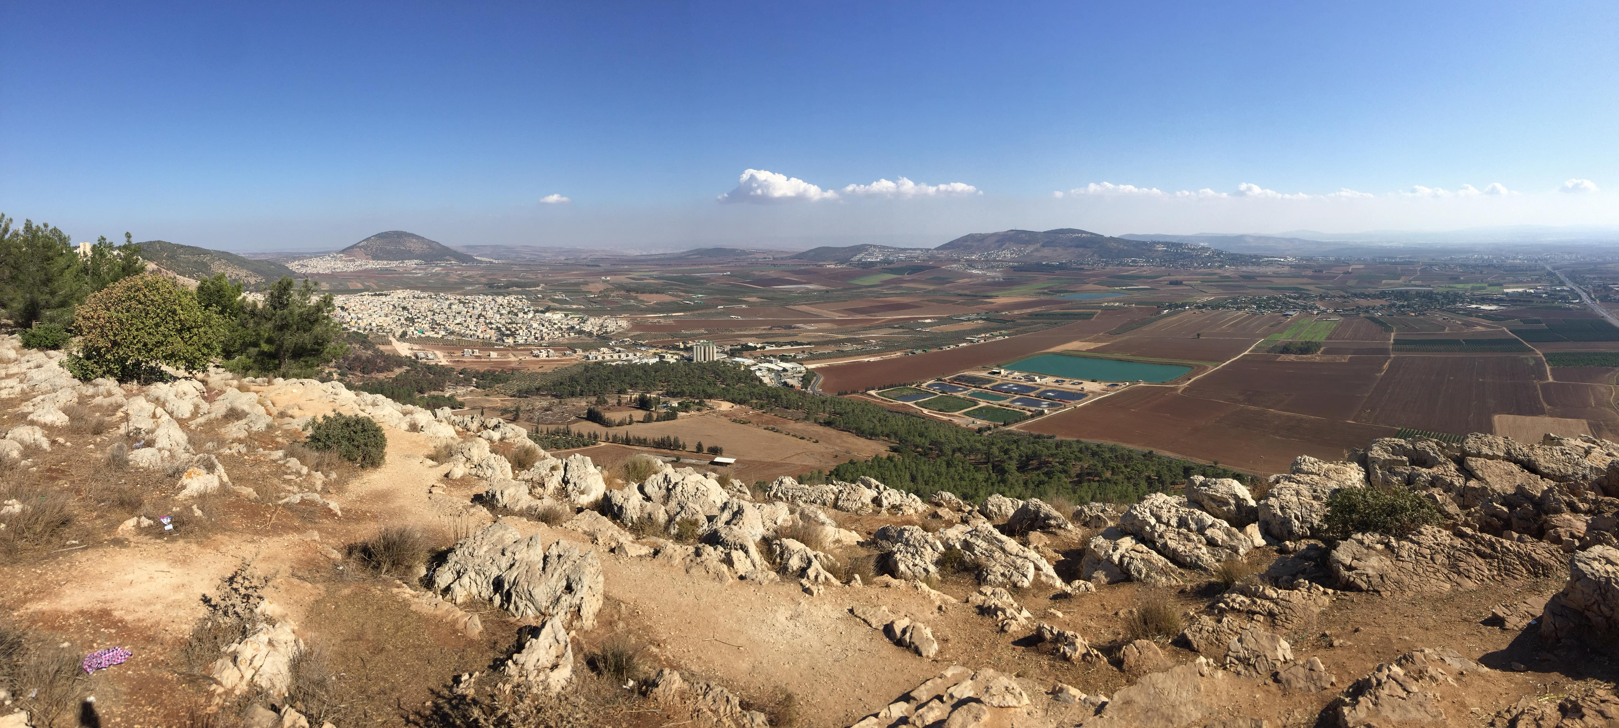
Filipino American Christian Church

Slide 9
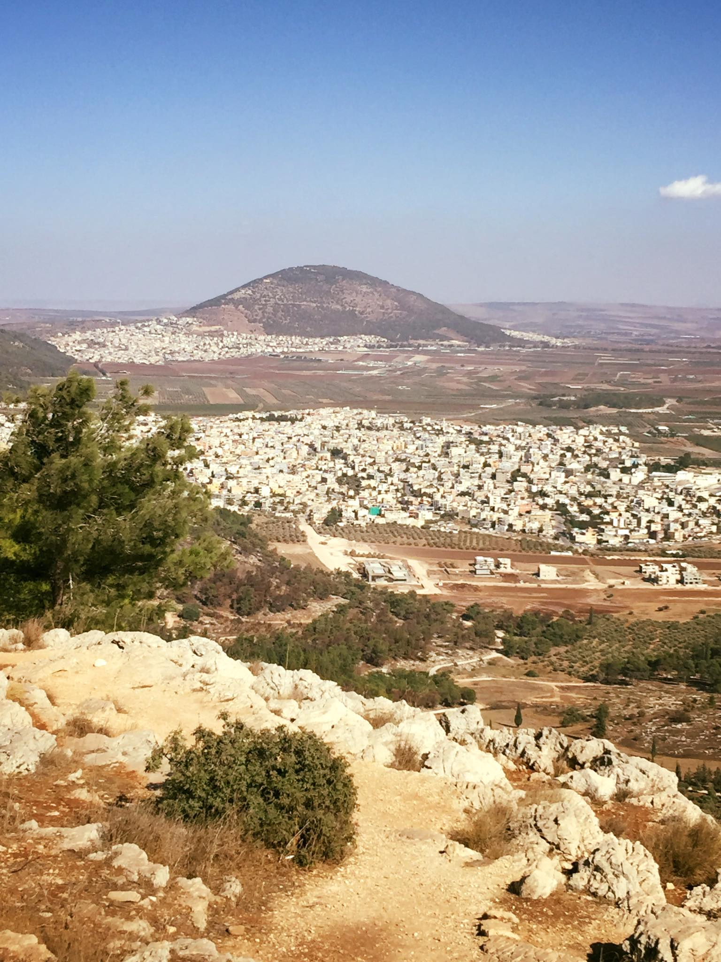
Filipino American Christian Church

Slide 10
Judges 4:14
And Deborah said to Barak, “Up! For this is the day in which the Lord has given Sisera into your hand. Does not the Lord go out before you?”

Slide 11
Judges 5:4
“Lord, when you went out from Seir, when you marched from the region of Edom, the earth trembled and the heavens dropped, yes, the clouds dropped water.

Slide 12
Judges 5:19-21
“The kings came, they fought; then fought the kings of Canaan, at Taanach, by the waters of Megiddo; they got no spoils of silver. From heaven the stars fought, from their courses they fought against Sisera. The torrent Kishon swept them away, the ancient torrent, the torrent Kishon. March on, my soul, with might!

Slide 13
Judges 4:15-16
And the Lord routed Sisera and all his chariots and all his army before Barak by the edge of the sword. And Sisera got down from his chariot and fled away on foot. And Barak pursued the chariots and the army to Harosheth-hagoyim, and all the army of Sisera fell by the edge of the sword; not a man was left.

Slide 14
Judges 4:17
But Sisera fled away on foot to the tent of Jael, the wife of Heber the Kenite, for there was peace between Jabin the king of Hazor and the house of Heber the Kenite.

Slide 15
Filipino American Christian Church

Slide 16
Judges 5:24-27
²⁴ “Most blessed of women be Jael, the wife of Heber the Kenite, of tent-dwelling women most blessed. ²⁵ He asked for water and she gave him milk; she brought him curds in a noble's bowl. ²⁶ She sent her hand to the tent peg and her right hand to the workmen's mallet; she struck Sisera;

Slide 17
Judges 5:24-27
she crushed his head; she shattered and pierced his temple. ²⁷ Between her feet he sank, he fell, he lay still; between her feet he sank, he fell; where he sank, there he fell—dead.

Slide 18
Filipino American Christian Church

Slide 19
And the hand of the people of Israel pressed harder and harder against Jabin the king of Canaan, until they destroyed Jabin king of Canaan
Judges 4:24
And the land had rest for forty years.
Judges 5:31

Slide 20
Filipino American Christian Church

Slide 21
Judges 4:23
So on that day God subdued Jabin
the king of Canaan before the people of Israel.

Slide 22
Filipino American Christian Church

Slide 23
Galatians 3:3-4
Grace to you and peace from God our Father and the Lord Jesus Christ, who gave himself for our sins to deliver us from the present evil age, according to the will of our God and Father, ⁵ to whom be the glory forever and ever. Amen.

Slide 24
Filipino American Christian Church

Slide 25
Israel’s special status as the people of God is not an end in itself but rather a means to an end, namely, the fulfillment of God’s universal purpose.

Slide 26
Filipino American Christian Church

