Slide 1
Filipino American Christian Church

Slide 2
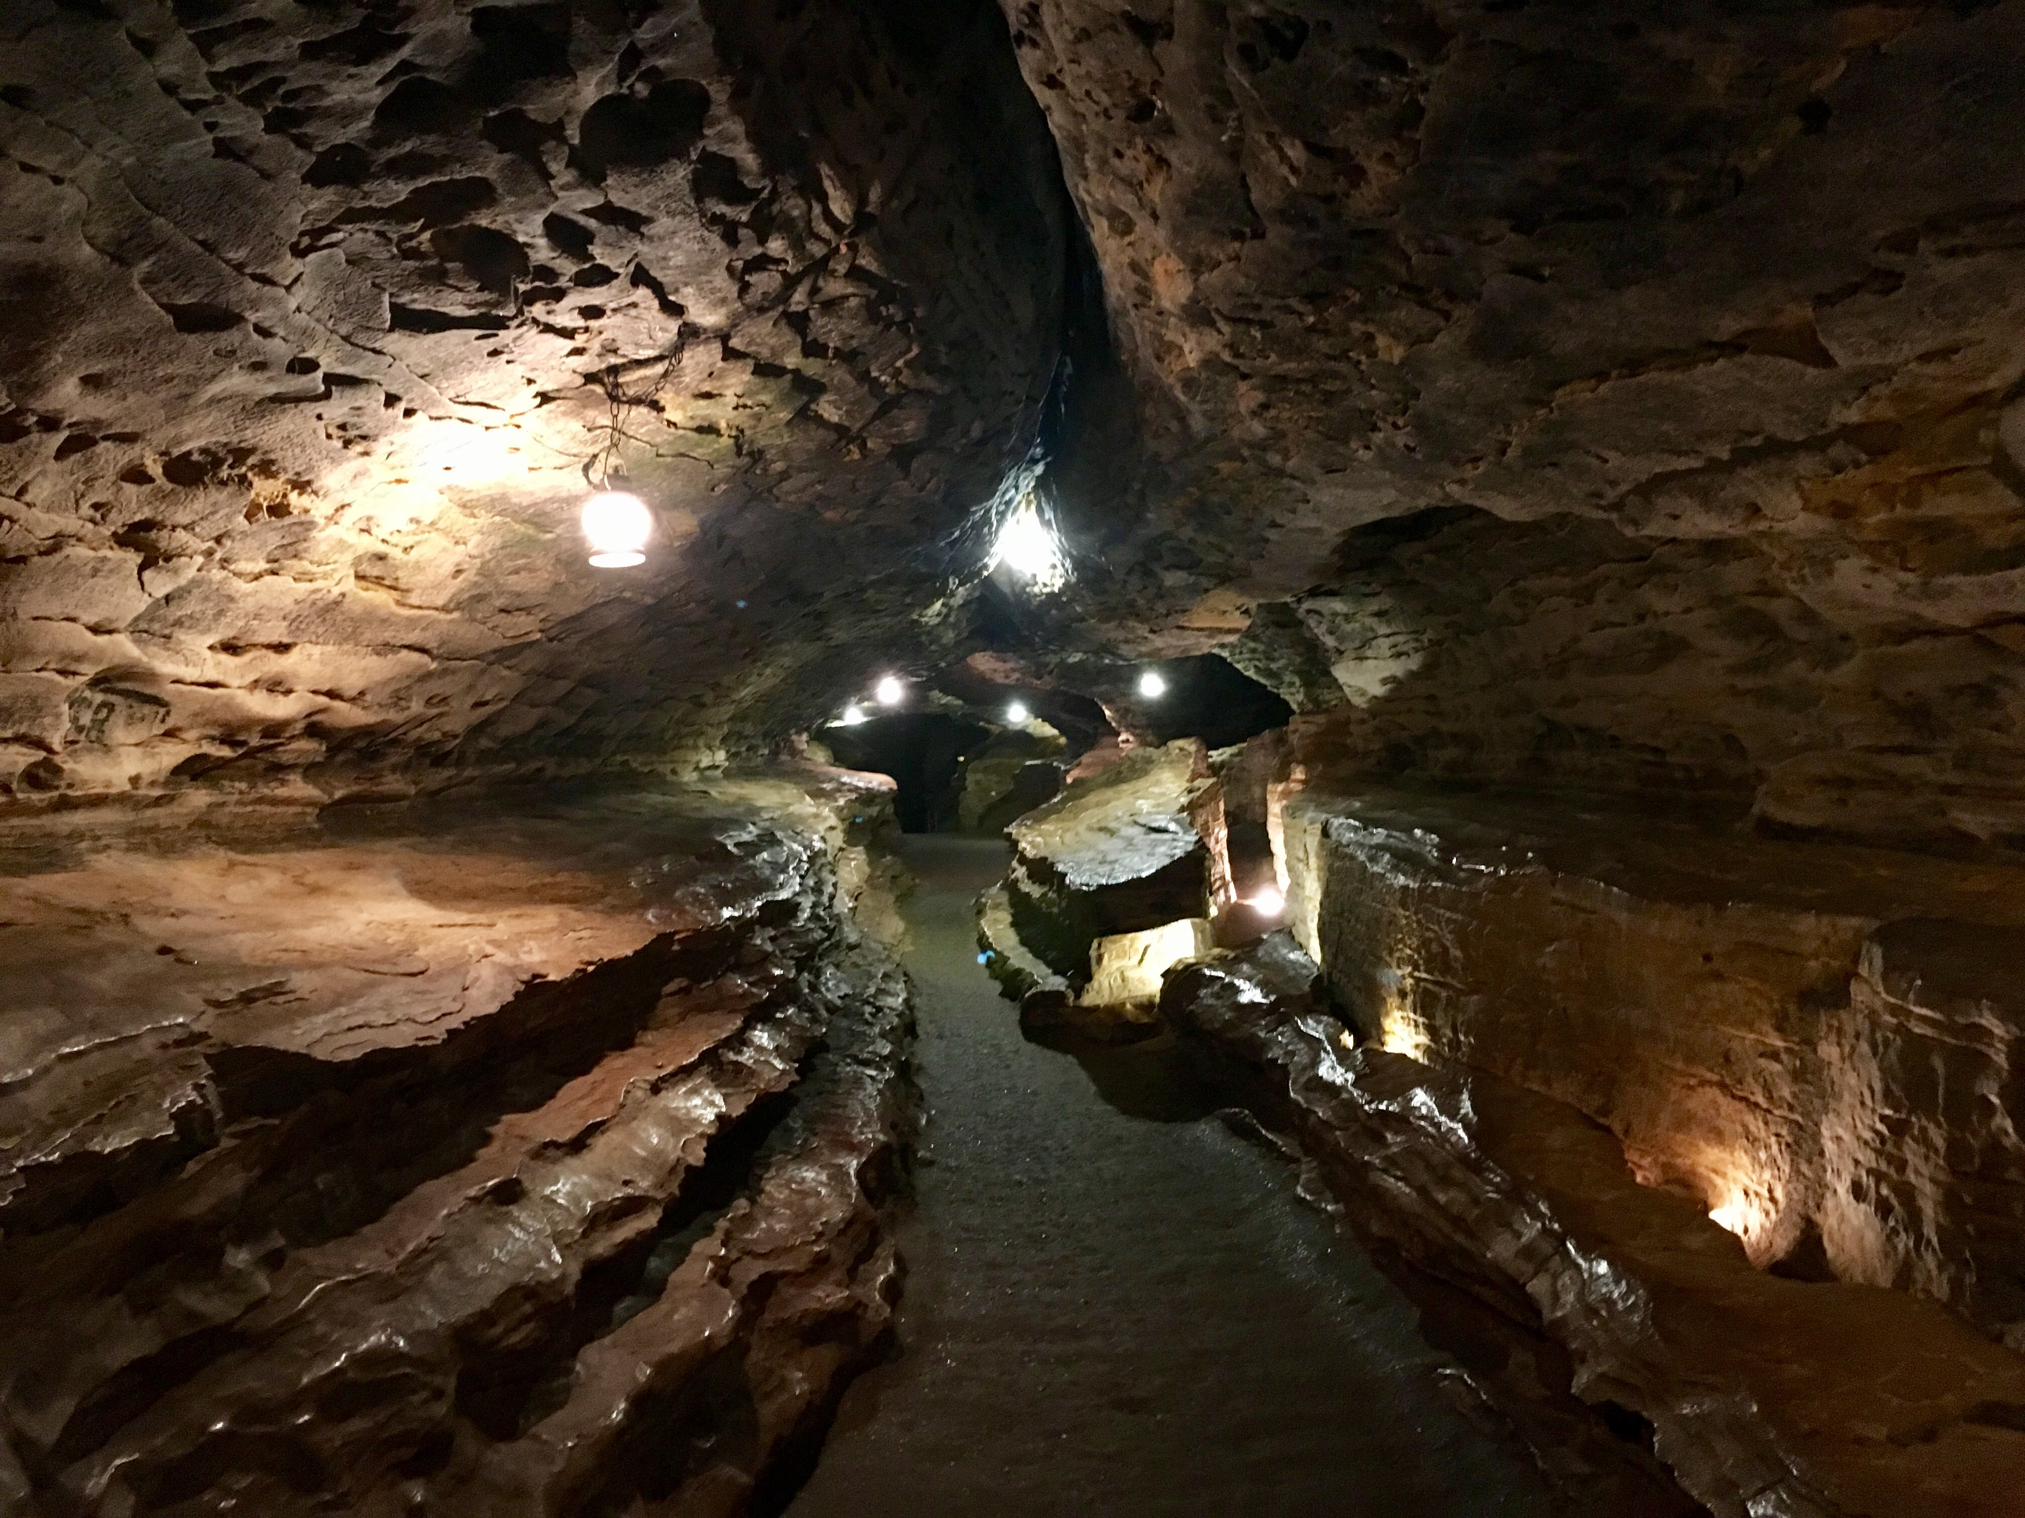
Filipino American Christian Church

Slide 3
Filipino American Christian Church

Slide 4
Judges 10:6-18
The people of Israel again did what was evil in the sight of the Lord and served the Baals and the Ashtaroth, the gods of Syria, the gods of Sidon, the gods of Moab, the gods of the Ammonites, and the gods of the Philistines. And they forsook the Lord and did not serve him. So the anger of the Lord was kindled against Israel, and he sold them into the hand of the Philistines and into the hand of the Ammonites, and they crushed and oppressed the people of Israel that year. For eighteen years they oppressed all the people of Israel who were beyond the Jordan in the land of the Amorites, which is in Gilead. And the Ammonites crossed the Jordan to fight also against Judah and against Benjamin and against the house of Ephraim, so that Israel was severely distressed.

Slide 5
Judges 10:6-18
And the people of Israel cried out to the Lord, saying, “We have sinned against you, because we have forsaken our God and have served the Baals.” And the Lord said to the people of Israel, “Did I not save you from the Egyptians and from the Amorites, from the Ammonites and from the Philistines? The Sidonians also, and the Amalekites and the Maonites oppressed you, and you cried out to me, and I saved you out of their hand. Yet you have forsaken me and served other gods; therefore I will save you no more. Go and cry out to the gods whom you have chosen; let them save you in the time of your distress.” And the people of Israel said to the Lord, “We have sinned; do to us whatever seems good to you. Only please deliver us this day.”

Slide 6
Judges 10:6-18
So they put away the foreign gods from among them and served the Lord, and he became impatient over the misery of Israel.
Then the Ammonites were called to arms, and they encamped in Gilead. And the people of Israel came together, and they encamped at Mizpah. And the people, the leaders of Gilead, said one to another, “Who is the man who will begin to fight against the Ammonites? He shall be head over all the inhabitants of Gilead.”

Slide 7
Filipino American Christian Church

Slide 8
Scene 1:
A Devious Pact
10:17-11:11

Slide 9
Judges 11:2
And Gilead's wife also bore him sons. And when his wife's sons grew up, they drove Jephthah out and said to him, “You shall not have an inheritance in our father's house, for you are the son of another woman.”

Slide 10
Judges 11:7-11
But Jephthah said to the elders of Gilead, “Did you not hate me and drive me out of my father's house? Why have you come to me now when you are in distress?” And the elders of Gilead said to Jephthah, “That is why we have turned to you now, that you may go with us and fight against the Ammonites and be our head over all the inhabitants of Gilead.” Jephthah said to the elders of Gilead, “If you bring me home again to fight against the Ammonites, and the Lord gives them over to me, I will be your head.” And the elders of Gilead said to Jephthah, “The Lord will be witness between us, if we do not do as you say.” So Jephthah went with the elders of Gilead, and the people made him head and leader over them. And Jephthah spoke all his words before the Lord at Mizpah.

Slide 11
Scene 2:
A Diplomatic Plea
11:12-28

Slide 12
Judges 11:28
But the king of the Ammonites did not listen to the words of Jephthah that he sent to him.

Slide 13
Scene 3:
A Disastrous Pledge
11:29-40

Slide 14
Judges 11:30-31
And Jephthah made a vow to the Lord and said, “If you will give the Ammonites into my hand, then whatever^{[a]} comes out from the doors of my house to meet me when I return in peace from the Ammonites shall be the Lord's, and I will offer it up for a burnt offering.”

Slide 15
Judges 11:34-39
Then Jephthah came to his home at Mizpah. And behold, his daughter came out to meet him with tambourines and with dances. She was his only child; besides her he had neither son nor daughter. And as soon as he saw her, he tore his clothes and said, “Alas, my daughter! You have brought me very low, and you have become the cause of great trouble to me. For I have opened my mouth to the Lord, and I cannot take back my vow.” And she said to him, “My father, you have opened your mouth to the Lord; do to me according to what has gone out of your mouth, now that the Lord has avenged you on your enemies, on the Ammonites.”

Slide 16
Judges 11:34-39
So she said to her father, “Let this thing be done for me: leave me alone two months, that I may go up and down on the mountains and weep for my virginity, I and my companions.” So he said, “Go.” Then he sent her away for two months, and she departed, she and her companions, and wept for her virginity on the mountains. And at the end of two months, she returned to her father, who did with her according to his vow that he had made.

Slide 17
Scene 4:
A Deadly Password
12:1-7

Slide 18
Judges 12:2-3
And Jephthah said to them, “I and my people had a great dispute with the Ammonites, and when I called you, you did not save me from their hand. And when I saw that you would not save me, I took my life in my hand and crossed over against the Ammonites, and the Lord gave them into my hand. Why then have you come up to me this day to fight against me?”

Slide 19
Filipino American Christian Church

Slide 20
Isaiah 53:3
He was despised and rejected by men, a man of sorrows and acquainted with grief; and as one from whom men hide their faces he was despised, and we esteemed him not.

Slide 21
Galatians 1:4
[Jesus] gave himself for our sins to deliver us from the present evil age, according to the will of our God and Father, to whom be the glory forever and ever. Amen.

Slide 22
Filipino American Christian Church

Slide 23
John 13:1
… when Jesus knew that his hour had come to depart out of this world to the Father, having loved his own who were in the world, he loved them to the end.

Slide 24
Filipino American Christian Church

