Slide 1
Filipino American Christian Church

Slide 3
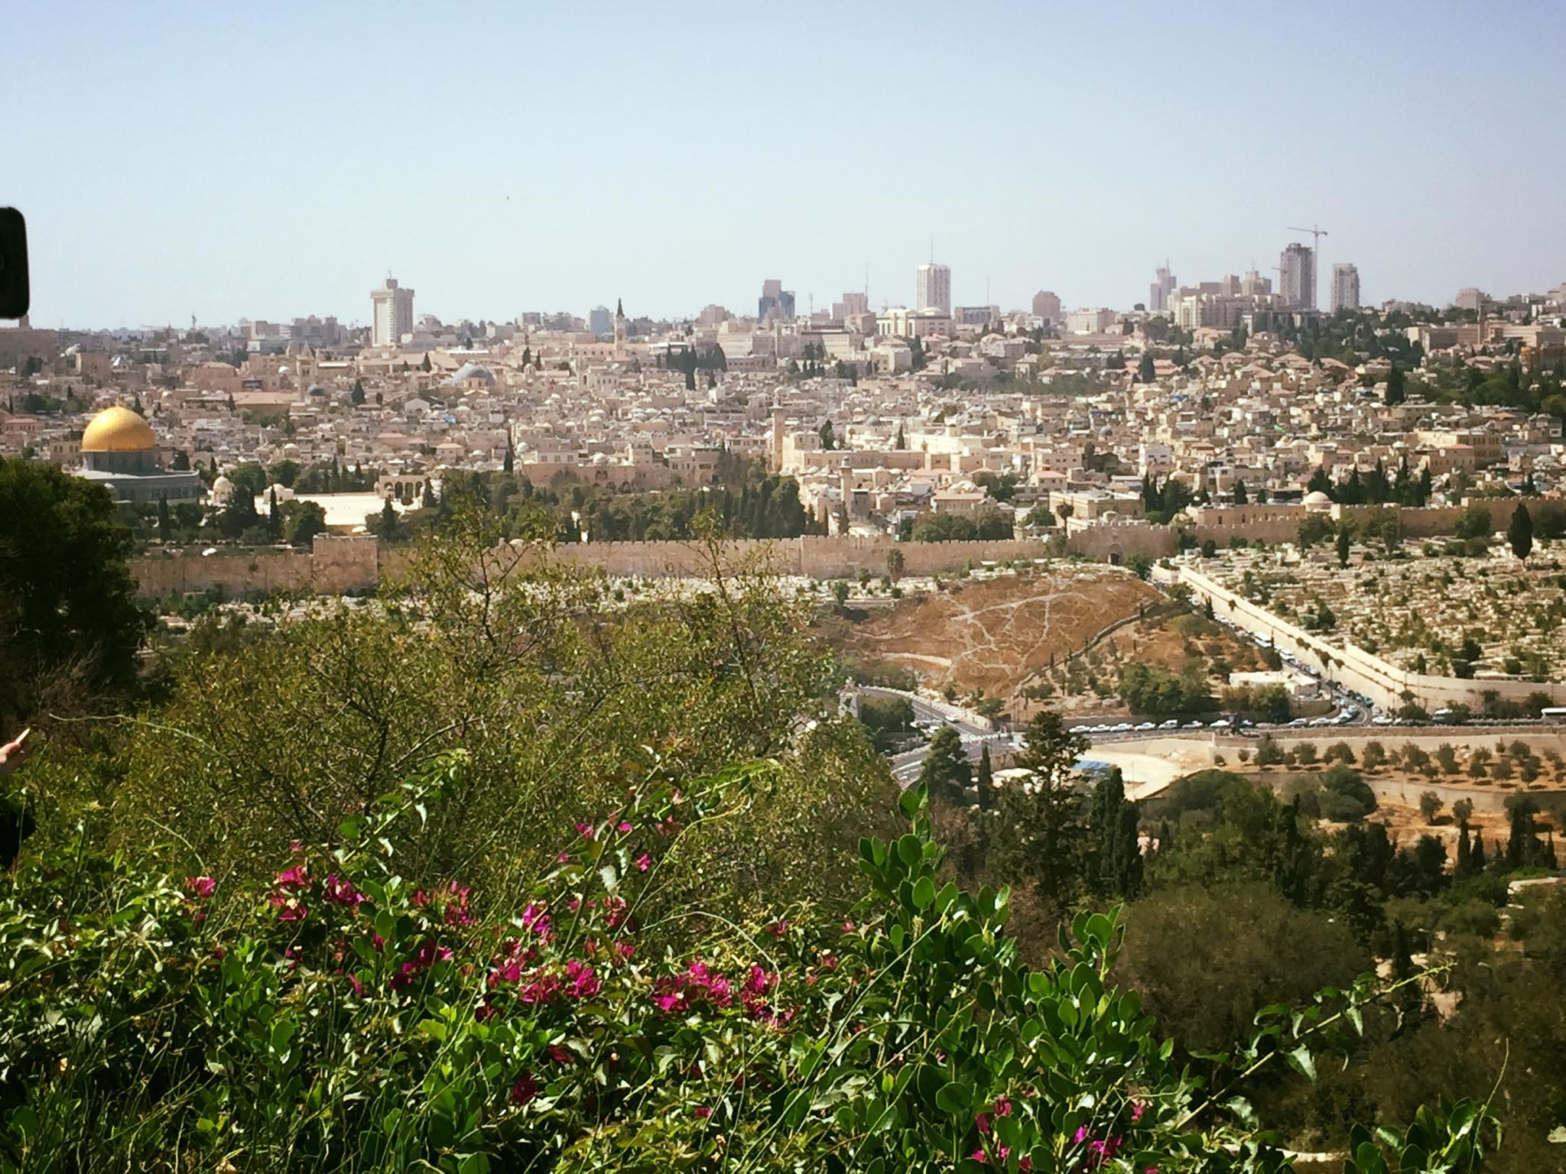

Slide 5
acts 1:12-26
Then they returned to Jerusalem from the mount called Olivet, which is near Jerusalem, a Sabbath day's journey away. And when they had entered, they went up to the upper room, where they were staying, Peter and John and James and Andrew, Philip and Thomas, Bartholomew and Matthew, James the son of Alphaeus and Simon the Zealot and Judas the son of James. All these with one accord were devoting themselves to prayer, together with the women and Mary the mother of Jesus, and his brothers. In those days Peter stood up among the brothers (the company of persons was in all about 120) and said, “Brothers, the Scripture had to be fulfilled, which the Holy Spirit spoke beforehand by the mouth of David concerning Judas …

Slide 6
acts 1:12-26
… who became a guide to those who arrested Jesus. For he was numbered among us and was allotted his share in this ministry.” (Now this man acquired a field with the reward of his wickedness, and falling headlong he burst open in the middle and all his bowels gushed out. And it became known to all the inhabitants of Jerusalem, so that the field was called in their own language Akeldama, that is, Field of Blood.) “For it is written in the Book of Psalms,
“‘May his camp become desolate,
and let there be no one to dwell in it’;
and
“‘Let another take his office.’

Slide 7
acts 1:12-26
So one of the men who have accompanied us during all the time that the Lord Jesus went in and out among us, beginning from the baptism of John until the day when he was taken up from us—one of these men must become with us a witness to his resurrection.” And they put forward two, Joseph called Barsabbas, who was also called Justus, and Matthias. And they prayed and said, “You, Lord, who know the hearts of all, show which one of these two you have chosen to take the place in this ministry and apostleship from which Judas turned aside to go to his own place.” And they cast lots for them, and the lot fell on Matthias, and he was numbered with the eleven apostles.

Slide 9
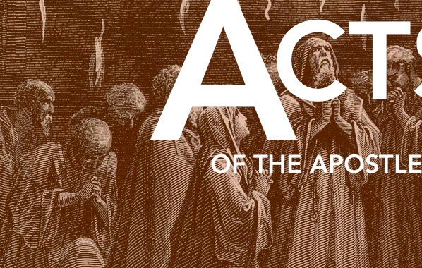
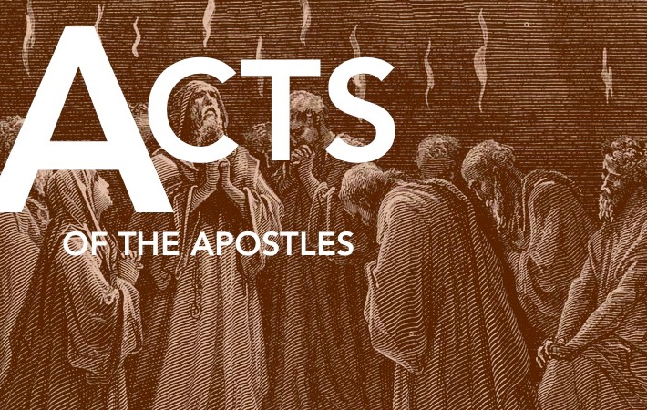
Seven Keys
The Sovereign God
The Risen Lord
The Empowering Spirit
The Witnessing Church
Transformed People
Reached Nations
Unstoppable Gospel

Slide 10
Key #1: The Sovereign God
Key #2: The Risen Lord
What will a growing awareness and confidence in those two things
(those first two keys) produce in a people?

Slide 13
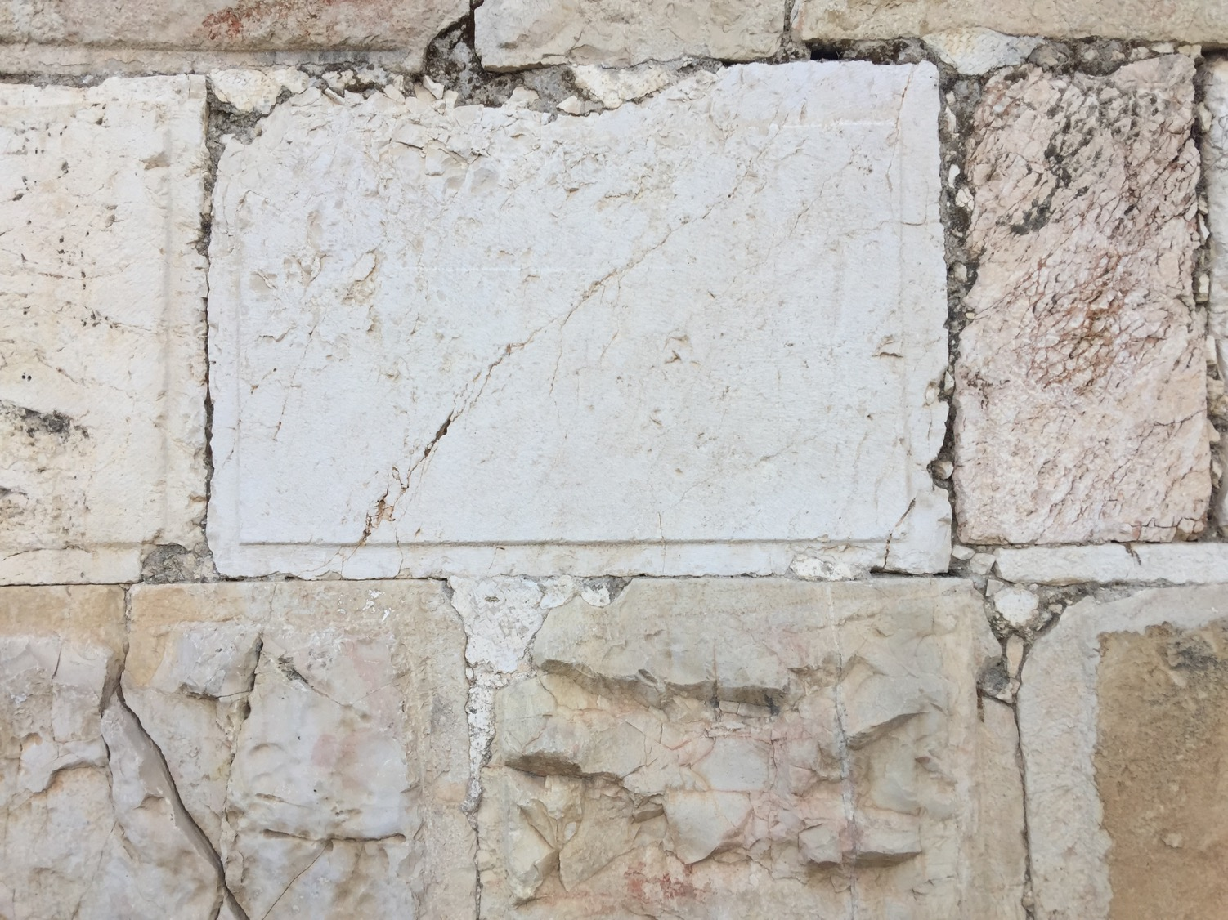

Slide 14
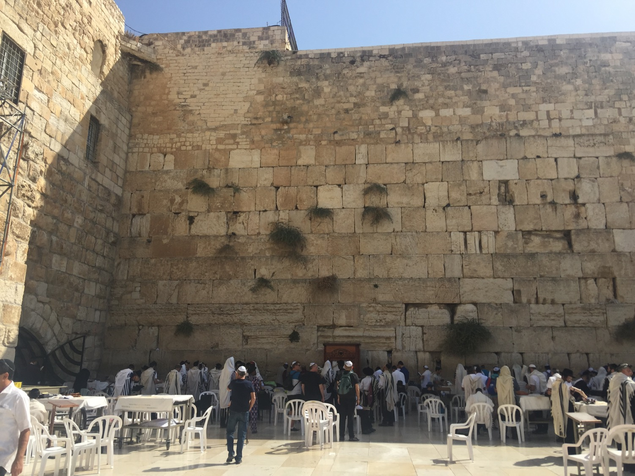

Slide 15
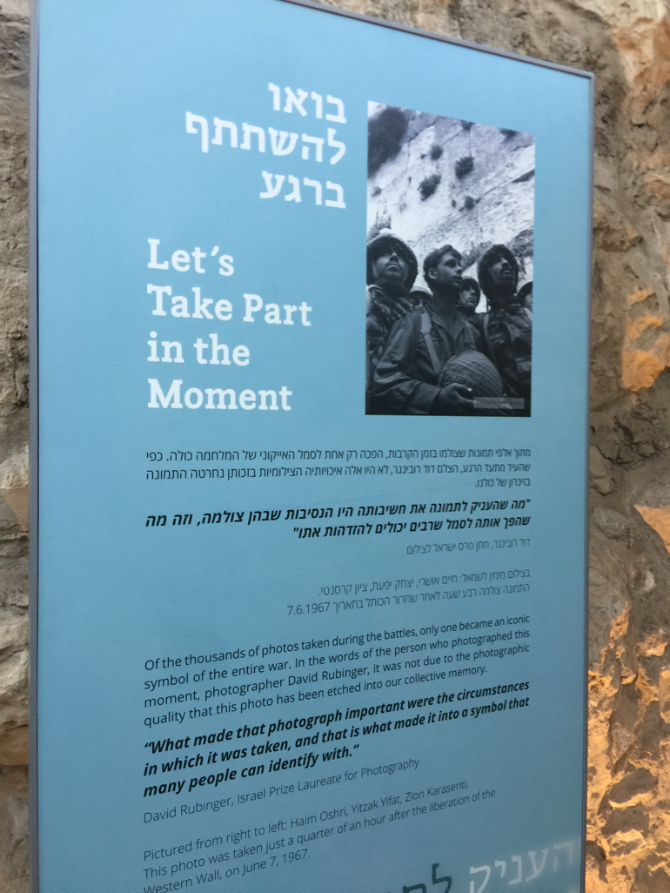
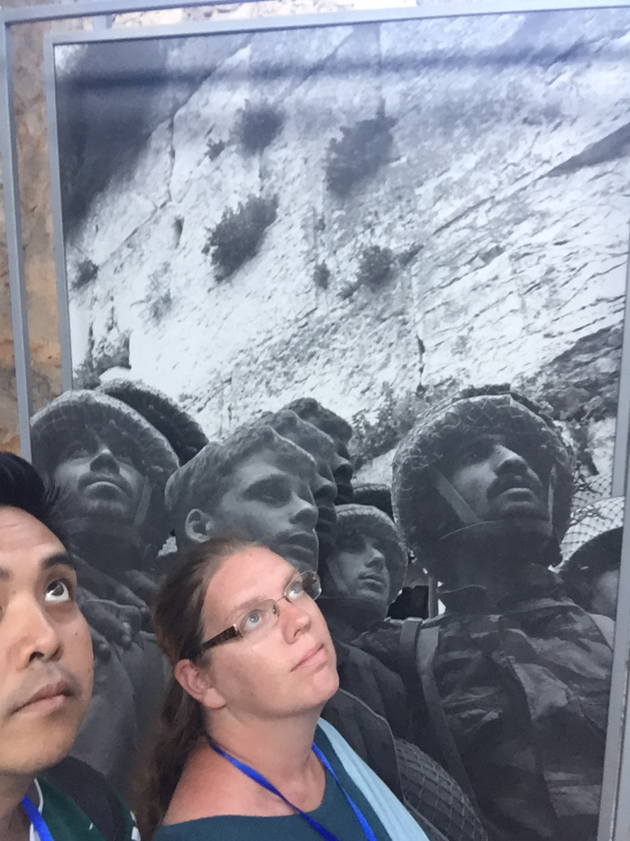

Slide 16
Three activities
in Acts 1
Confident Waiting
Informed Obedience
Dependent Prayer

Slide 18
Three activities
in Acts 1
Confident Waiting

Slide 19
acts 1:4-5
And while staying with them he ordered them not to depart from Jerusalem, but to wait for the promise of the Father, which, he said, “you heard from me; for John baptized with water, but you will be baptized with the Holy Spirit not many days from now.”

Slide 20
acts 2:1-4
When the day of Pentecost arrived, they were all together in one place. And suddenly there came from heaven a sound like a mighty rushing wind, and it filled the entire house where they were sitting. And divided tongues as of fire appeared to them and rested on each one of them. And they were all filled with the Holy Spirit and began to speak in other tongues as the Spirit gave them utterance.

Slide 21
Second only to suffering, waiting may be the greatest teacher and trainer in godliness and maturity and genuine spirituality most of us ever encounter.

Slide 23
Three activities
in Acts 1
Confident Waiting
Informed Obedience

Slide 24
acts 1:16
Brothers, the Scripture had to be fulfilled, which the Holy Spirit spoke beforehand by the mouth of David concerning Judas.

Slide 25
acts 1:20
“For it is written in the Book of Psalms,
“‘May his camp become desolate,
and let there be no one to dwell in it’;
and
‘Let another take his office.’”

Slide 26
acts 1:23-26
And they put forward two, Joseph called Barsabbas, who was also called Justus, and Matthias. And they prayed and said, “You, Lord, who know the hearts of all, show which one of these two you have chosen to take the place in this ministry and apostleship from which Judas turned aside to go to his own place.” And they cast lots for them …

Slide 28
Three activities
in Acts 1
Confident Waiting
Informed Obedience
Dependent Prayer

Slide 29
acts 1:14
All these with one accord were devoting themselves to prayer, together …

Slide 30
acts 1:20
“For it is written in the Book of Psalms,
“‘May his camp become desolate,
and let there be no one to dwell in it’;
and
‘Let another take his office.’”

Slide 31
“I have a great need for God, and I have a great God for my need.”
-Charles Spurgeon

Slide 33
Filipino American Christian Church

