Slide 1
Filipino American Christian Church

Slide 2
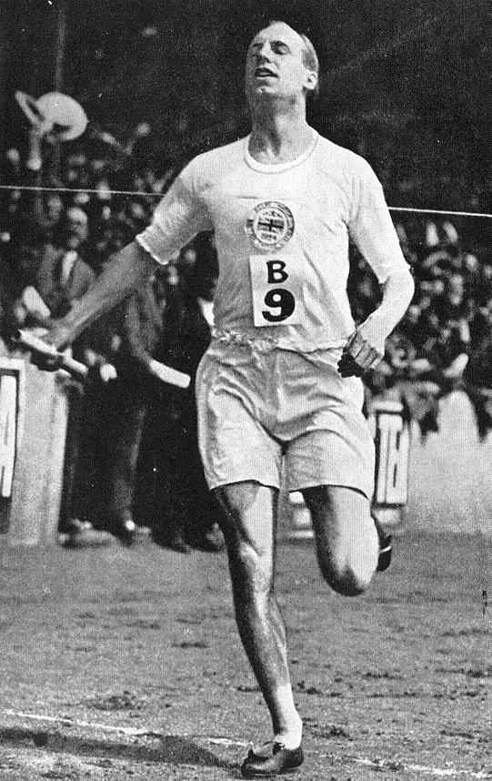
Filipino American Christian Church

Slide 3
Filipino American Christian Church

Slide 4
Judges 17:1-6
There was a man of the hill country of Ephraim, whose name was Micah. And he said to his mother, “The 1,100 pieces of silver that were taken from you, about which you uttered a curse, and also spoke it in my ears, behold, the silver is with me; I took it.” And his mother said, “Blessed be my son by the Lord.” And he restored the 1,100 pieces of silver to his mother. And his mother said, “I dedicate the silver to the Lord from my hand for my son, to make a carved image and a metal image. Now therefore I will restore it to you.”

Slide 5
Judges 17:1-6
So when he restored the money to his mother, his mother took 200 pieces of silver and gave it to the silversmith, who made it into a carved image and a metal image. And it was in the house of Micah. And the man Micah had a shrine, and he made an ephod and household gods, and ordained one of his sons, who became his priest. In those days there was no king in Israel. Everyone did what was right in his own eyes.

Slide 6
Filipino American Christian Church

Slide 7
Judges 17:1-6
Now there was a young man of Bethlehem in Judah, of the family of Judah, who was a Levite, and he sojourned there. And the man departed from the town of Bethlehem in Judah to sojourn where he could find a place. And as he journeyed, he came to the hill country of Ephraim to the house of Micah. And Micah said to him, “Where do you come from?” And he said to him, “I am a Levite of Bethlehem in Judah, and I am going to sojourn where I may find a place.”

Slide 8
Judges 17:7-13
And Micah said to him, “Stay with me, and be to me a father and a priest, and I will give you ten pieces of silver a year and a suit of clothes and your living.” And the Levite went in. And the Levite was content to dwell with the man, and the young man became to him like one of his sons. And Micah ordained the Levite, and the young man became his priest, and was in the house of Micah. Then Micah said, “Now I know that the Lord will prosper me, because I have a Levite as priest.”

Slide 9
Filipino American Christian Church

Slide 10
Judges 18:1
In those days there was no king in Israel. And in those days the tribe of the people of Dan was seeking for itself an inheritance to dwell in, for until then no inheritance among the tribes of Israel had fallen to them …

Slide 11
Judges 1:34
The Amorites pressed the people of Dan back into the hill country, for they did not allow them to come down to the plain.

Slide 12
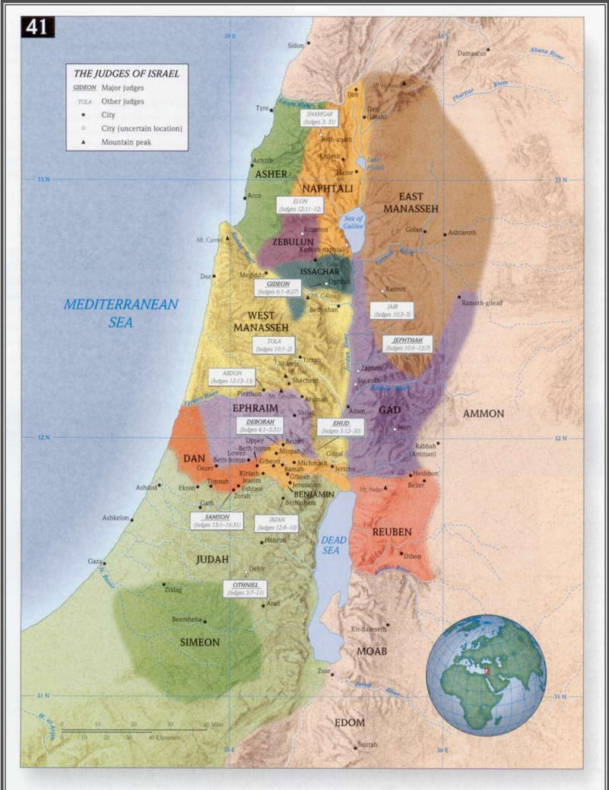
Filipino American Christian Church

Slide 13
Judges 18:5-6
And they said to him, “Inquire of God, please, that we may know whether the journey on which we are setting out will succeed.” And the priest said to them, “Go in peace. The journey on which you go is under the eye of the Lord.”

Slide 14
Judges 18:14-17
Then the five men who had gone to scout out the country of Laish said to their brothers, “Do you know that in these houses there are an ephod, household gods, a carved image, and a metal image? Now therefore consider what you will do.” And they turned aside there and came to the house of the young Levite, at the home of Micah, and asked him about his welfare. Now the 600 men of the Danites, armed with their weapons of war, stood by the entrance of the gate. And the five men who had gone to scout out the land went up and entered and took the carved image, the ephod, the household gods, and the metal image, while the priest stood by the entrance of the gate with the 600 men armed with weapons of war.

Slide 15
Judges 18:18-20
And when these went into Micah's house and took the carved image, the ephod, the household gods, and the metal image, the priest said to them, “What are you doing?” And they said to him, “Keep quiet; put your hand on your mouth and come with us and be to us a father and a priest. Is it better for you to be priest to the house of one man, or to be priest to a tribe and clan in Israel?” And the priest's heart was glad. He took the ephod and the household gods and the carved image and went along with the people.

Slide 16
Filipino American Christian Church

Slide 17
Judges 18:28-31
Then they rebuilt the city and lived in it. And they named the city Dan, after the name of Dan their ancestor, who was born to Israel; but the name of the city was Laish at the first. And the people of Dan set up the carved image for themselves, and Jonathan the son of Gershom, son of Moses, and his sons were priests to the tribe of the Danites until the day of the captivity of the land. So they set up Micah's carved image that he made, as long as the house of God was at Shiloh.

Slide 18
Filipino American Christian Church

Slide 19
1) The human heart is bent on lawlessness and rebellion … and …
2) The human heart longs to worship

Slide 20
The degree to which we abandon our worship of God in the way that He has ordained, is also the degree to which we’ve begun to worship something else.

Slide 21
Judges 17:13
Then Micah said,
“Now I know that the Lord will prosper me,
because I have a Levite as priest.”

Slide 22
Filipino American Christian Church

Slide 23
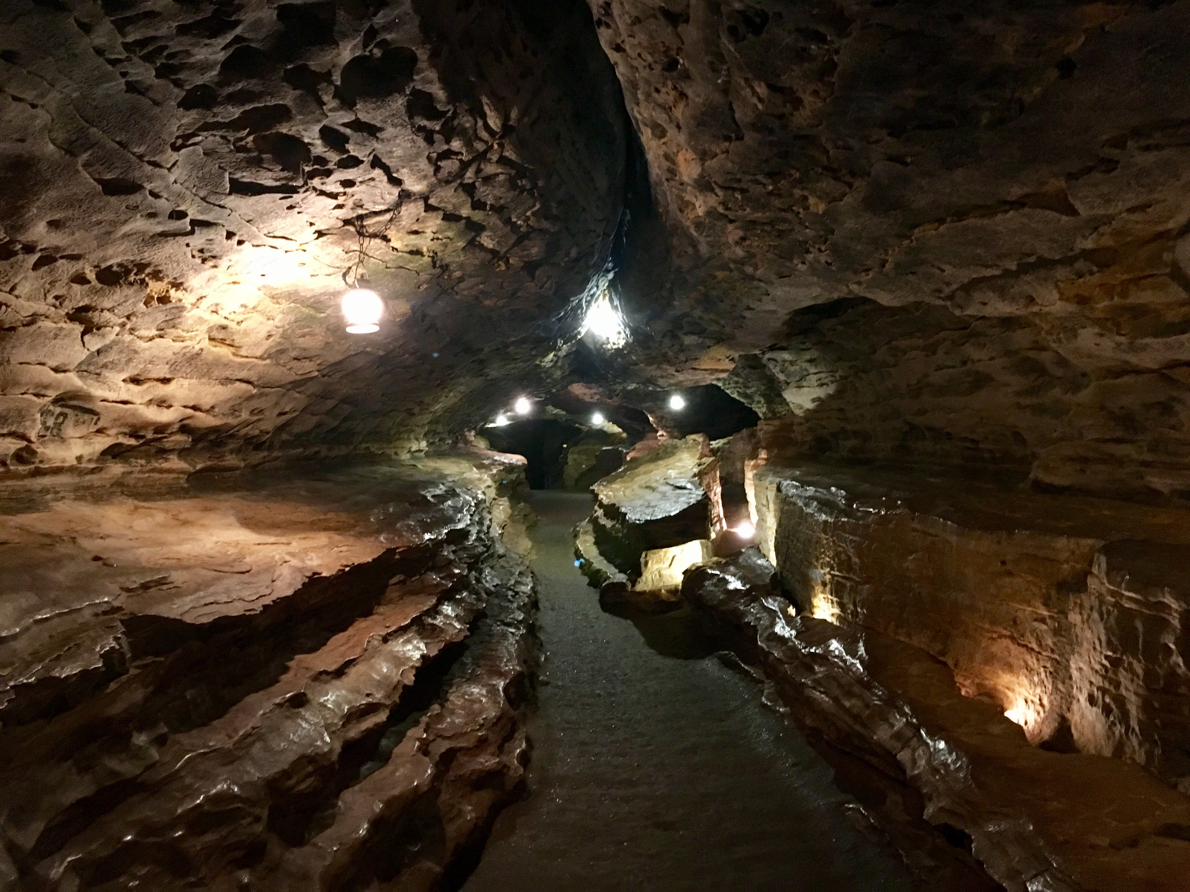
Filipino American Christian Church

Slide 24
Filipino American Christian Church

