Slide 1
Filipino American Christian Church

Slide 2
Filipino American Christian Church

Slide 3
Filipino American Christian Church

Slide 4
Four Scenes
• First Scene (Acts 21:1-16)

Slide 5
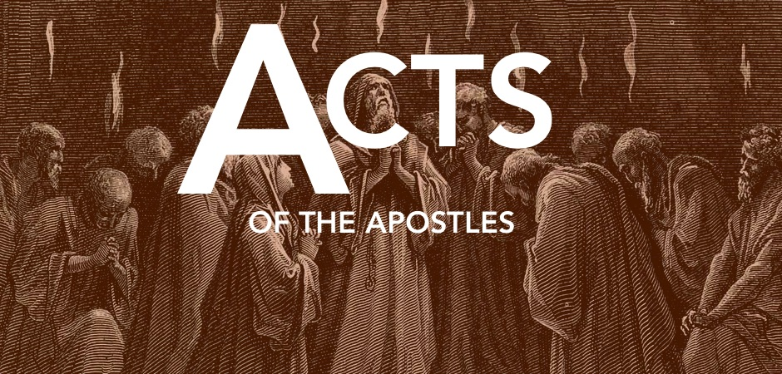
Four Scenes
Scene 1 (Acts 21:1-16)

Slide 6
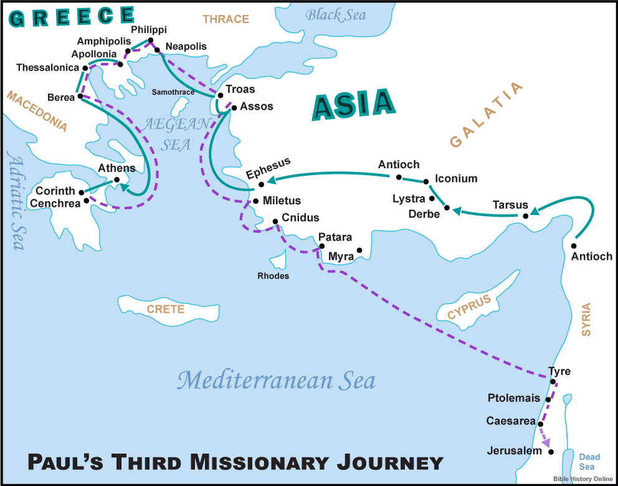

Slide 7
Four Scenes
• First Scene (Acts 21:1-16)
Paul is headed to Jerusalem in obedience to God, despite the risk.

Slide 8
Four Scenes
• First Scene (Acts 21:1-16)
Paul is headed to Jerusalem in obedience to God, despite the risk.
• Second Scene (Acts 21:17-26)

Slide 9
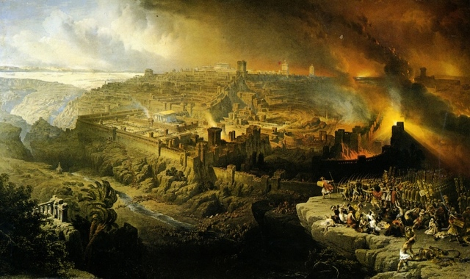
Filipino American Christian Church

Slide 10
Filipino American Christian Church

Slide 11
Four Scenes
• First Scene (Acts 21:1-16)
• Second Scene (Acts 21:17-26)

Slide 12
1 Corinthians 9:19-23
For though I am free from all, I have made myself a servant to all, that I might win more of them. To the Jews I became as a Jew, in order to win Jews. To those under the law I became as one under the law (though not being myself under the law) that I might win those under the law. To those outside the law I became as one outside the law (not being outside the law of God but under the law of Christ) that I might win those outside the law. To the weak I became weak, that I might win the weak. I have become all things to all people, that by all means I might save some. I do it all for the sake of the gospel, that I may share with them in its blessings.

Slide 13
Four Scenes
• First Scene (Acts 21:1-16)
• Second Scene (Acts 21:17-26)

Slide 14
Four Scenes
• First Scene (Acts 21:1-16)
• Second Scene (Acts 21:17-26)
• Third Scene (Acts 21:27-22:29)

Slide 15
Four Scenes
• First Scene (Acts 21:1-16)
• Second Scene (Acts 21:17-26)
• Third Scene (Acts 21:27-22:29)
• Fourth Scene (Acts 22:30-23:11)

Slide 16
Filipino American Christian Church

Slide 17
Four Lessons
• First Scene: Be ready to accept risk for sharing the Gospel

Slide 18
Four Lessons
• First Scene: Be ready to accept risk for sharing the Gospel
• Second Scene: Be ready to do what you can to make sure your sharing of the Gospel isn’t NEEDLESSLY offensive (keep in mind, sometimes it needs to be).

Slide 19
Four Lessons
• First Scene: Be ready to accept risk for sharing the Gospel
• Second Scene: Be ready to do what you can to make sure your sharing of the Gospel isn’t NEEDLESSLY offensive (keep in mind, sometimes it needs to be).
• Third Scene: Be ready to talk about what God has done, and how that has CHANGED YOU.

Slide 20
Four Lessons
• First Scene: Be ready to accept risk for sharing the Gospel
• Second Scene: Be ready to do what you can to make sure your sharing of the Gospel isn’t NEEDLESSLY offensive (keep in mind, sometimes it needs to be).
• Third Scene: Be ready to talk about what God has done, and how that has CHANGED YOU.
• Fourth Scene: Be ready to build bridges to the Gospel rom a starting point of shared belief.

Slide 21
Filipino American Christian Church

