Slide 2
What is
all about?

Slide 3
“… here we sit, all of us, eating and drinking to preserve our precious existence, and really there is
nothing—no reason—for existing.”
-Jean Paul Sartre

Slide 4
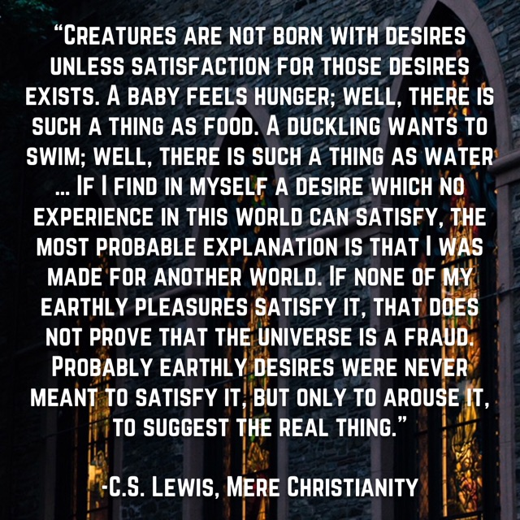

Slide 6
Acts 1:8
“But you will receive power when the Holy Spirit has come on you, and you will be My witnesses in Jerusalem, in all Judea and Samaria, and to the ends of the earth.”

Slide 7
“And the word of God continued to increase, and the number of the disciples multiplied greatly in Jerusalem, and a great many of the priests became obedient to the faith.”
-Acts 6:7
“So the church throughout all Judea and Galilee and Samaria had peace and was being built up. And walking in the fear of the Lord and in the comfort of the Holy Spirit, it multiplied.”
-Acts 9:31

Slide 8
Acts 13:1-3
Now there were in the church at Antioch prophets and teachers, Barnabas, Simeon who was called Niger, Lucius of Cyrene, Manaen a lifelong friend of Herod the tetrarch, and Saul. While they were worshiping the Lord and fasting, the Holy Spirit said, “Set apart for me Barnabas and Saul for the work to which I have called them.” Then after fasting and praying they laid their hands on them and
sent them off.

Slide 9
Acts 14:24-28
Then they passed through Pisidia and came to Pamphylia. And when they had spoken the word in Perga, they went down to Attalia, and from there they sailed to Antioch, where they had been commended to the grace of God for the work that they had fulfilled. And when they arrived and gathered the church together, they declared all that God had done with them, and how he had opened a door of faith to the Gentiles. And they remained no little time with the disciples.

Slide 10
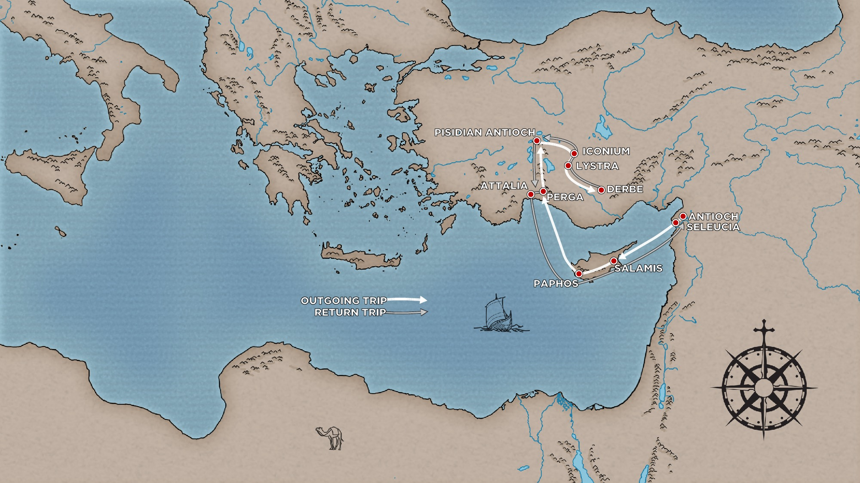

Slide 11
“While they were worshiping the Lord and fasting, the Holy Spirit said, ‘Set apart for me Barnabas and Saul for the work to which I have called them.’”
-Acts 13:2
“and from there they sailed to Antioch, where they had been commended to the grace of God for the work that they had fulfilled.”
-Acts 14:26

Slide 14
“When they arrived at Salamis, they proclaimed the word of God”
-Acts 13:5
“He was with the proconsul, Sergius Paulus, a man of intelligence, who summoned Barnabas and Saul and sought to hear the word of God.”
-Acts 13:7
"And we bring you the good news that what God promised to the fathers, this he has fulfilled to us their children by raising Jesus”
-Acts 13:32-33
“And Paul and Barnabas spoke out boldly, saying, ‘It was necessary that the word of God be spoken first to you.’”
-Acts 13:46

Slide 15
“So they remained for a long time, speaking boldly for the Lord, who bore witness
to the word of his grace”
-Acts 14:3
“and there they continued to preach the gospel.”
-Acts 14:7
“When they had preached the gospel
to that city [Derbe]”
-Acts 14:21
“ And when they had spoken the word in Perga, they went down to Attalia”
-Acts 14:25

Slide 17
What is
all about?

Slide 18
What is
God, through Jesus Christ, has provided rescue for mankind, saving us from guilt and judgment, and giving us the life that God intended us to have when He created us.
all about?

Slide 20
Acts 13:13-16
Now Paul and his companions set sail from Paphos and came to Perga in Pamphylia. And John left them and returned to Jerusalem, but they went on from Perga and came to Antioch in Pisidia. And on the Sabbath day they went into the synagogue and sat down. After the reading from the Law and the Prophets, the rulers of the synagogue sent a message to them, saying, “Brothers, if you have any word of encouragement for the people, say it.” So Paul stood up, and motioning with his hand said: “Men of Israel and you who fear God, listen …”

Slide 21
Acts 13:42-49
As they went out, the people begged that these things might be told them the next Sabbath. And after the meeting of the synagogue broke up, many Jews and devout converts to Judaism followed Paul and Barnabas, who, as they spoke with them, urged them to continue in the grace of God. The next Sabbath almost the whole city gathered to hear the word of the Lord. But when the Jews saw the crowds, they were filled with jealousy and began to contradict what was spoken by Paul, reviling him.

Slide 22
Acts 13:42-49
And Paul and Barnabas spoke out boldly, saying, “It was necessary that the word of God be spoken first to you. Since you thrust it aside and judge yourselves unworthy of eternal life, behold, we are turning to the Gentiles. For so the Lord has commanded us, saying,
“‘I have made you a light for the Gentiles, that you may bring salvation to the ends of the earth.’”
And when the Gentiles heard this, they began rejoicing and glorifying the word of the Lord, and as many as were appointed to eternal life believed. And the word of the Lord was spreading throughout the whole region.

Slide 24
Acts 14:15-17
“‘Men, why are you doing these things? We also are men, of like nature with you, and we bring you good news, that you should turn from these vain things to a living God, who made the heaven and the earth and the sea and all that is in them. In past generations he allowed all the nations to walk in their own ways. Yet he did not leave himself without witness, for he did good by giving you rains from heaven and fruitful seasons, satisfying your hearts with food and gladness.’”

Slide 25
Acts 13:16-17, 23
“So Paul stood up, and motioning with his hand said:
‘Men of Israel and you who fear God, The God of this people Israel …’”
“Of this man's offspring God has brought to Israel a Savior, Jesus, as he promised.”

Slide 27
“Let it be known to you therefore, brothers, that through this man forgiveness of sins is proclaimed to you, and by him everyone who believes is freed from everything from which you could not be freed by the law of Moses.”
-Acts 13:38-39
What is
all about?

