Slide 1
Filipino American Christian Church

Slide 2
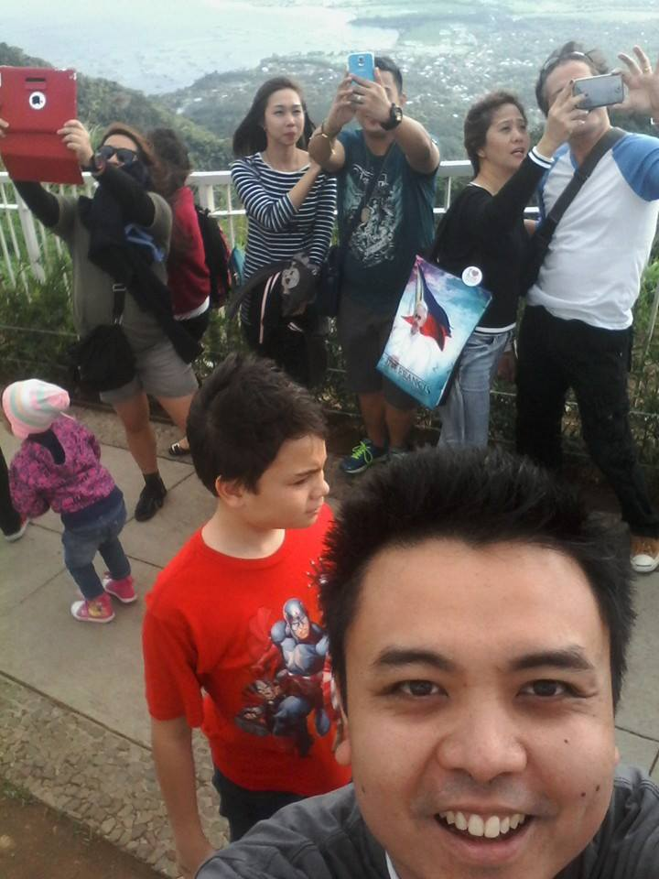

Slide 4
acts 2:42-47
And they devoted themselves to the apostles' teaching and the fellowship, to the breaking of bread and the prayers. And awe came upon every soul, and many wonders and signs were being done through the apostles. And all who believed were together and had all things in common. And they were selling their possessions and belongings and distributing the proceeds to all, as any had need. And day by day, attending the temple together and breaking bread in their homes, they received their food with glad and generous hearts, praising God and having favor with all the people. And the Lord added to their number day by day those who were being saved.

Slide 6
acts 2:42
And they devoted themselves to the
apostles' teaching and the fellowship,
to the breaking of bread and the prayers.

Slide 7
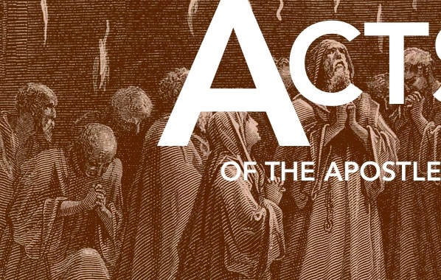
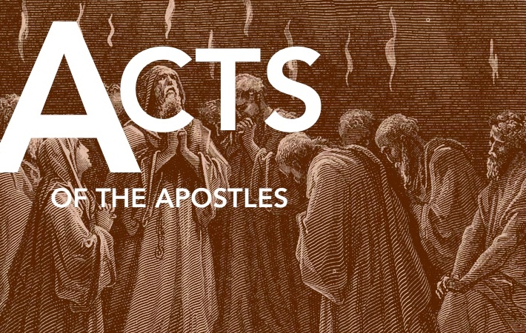
Four Priorities /
Distinguishing Characteristics:
The Apostle’s Teaching

Slide 8
acts 2:42
And they devoted themselves to the
apostles' teaching …

Slide 9
Matthew 18:19-20
“Go therefore and make disciples of all nations, baptizing them in the name of the Father and of the Son and of the Holy Spirit, teaching them to observe all that I have commanded you. And behold, I am with you always, to the end of the age.”

Slide 10
acts 2:46
“… and day by day, [they were] attending
the temple together …”

Slide 11
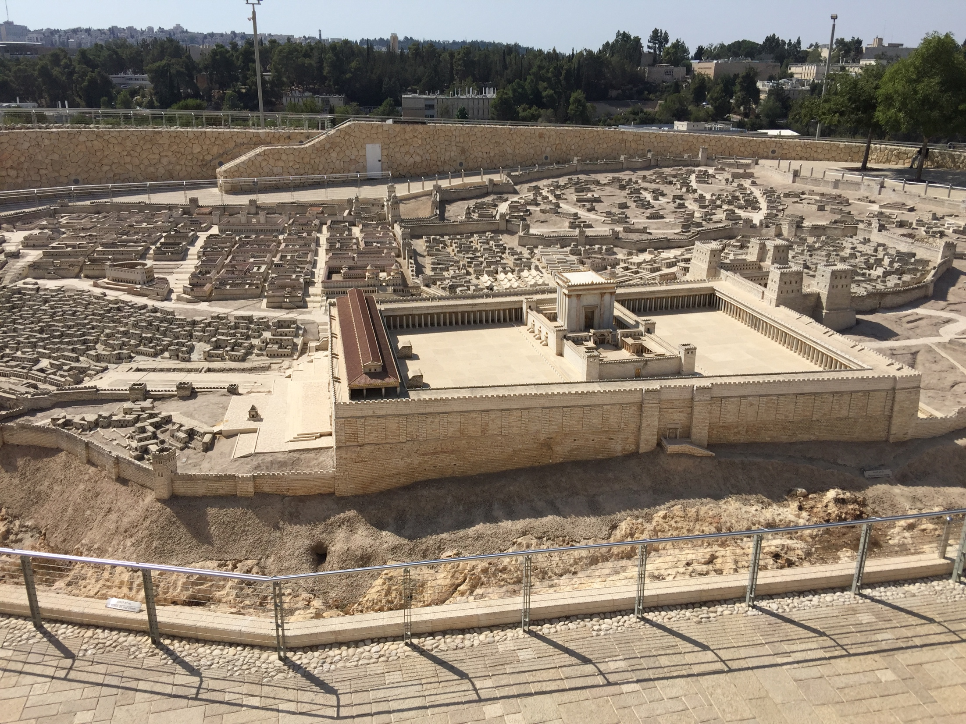

Slide 12
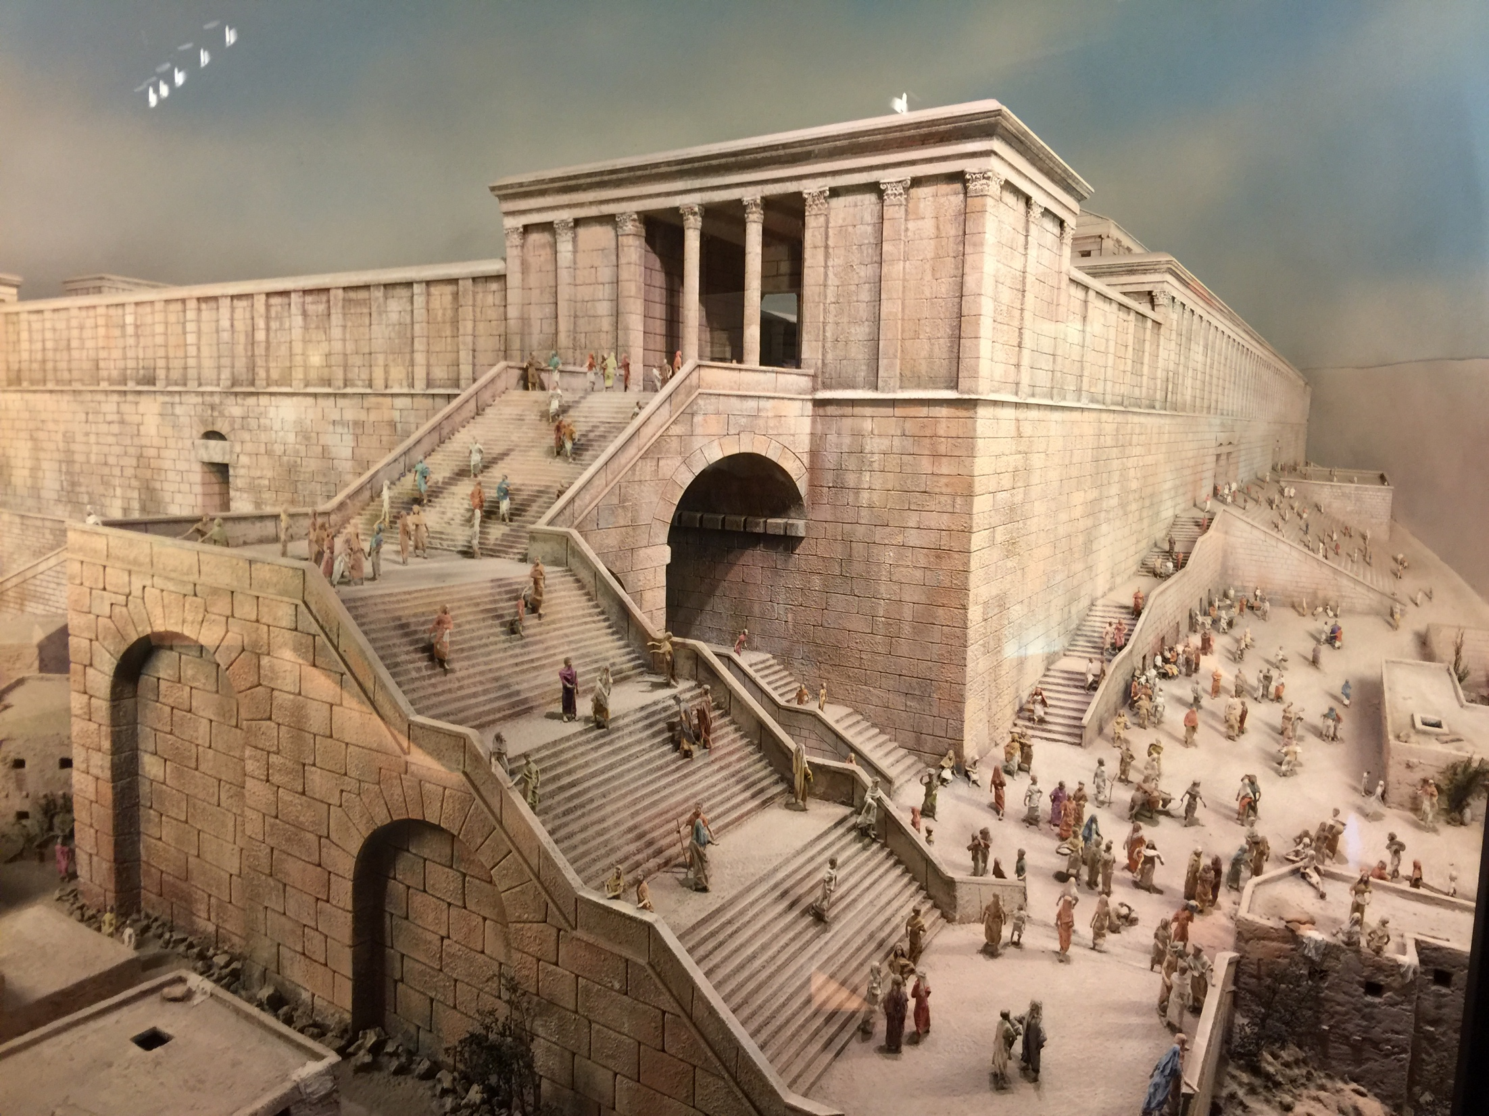

Slide 13
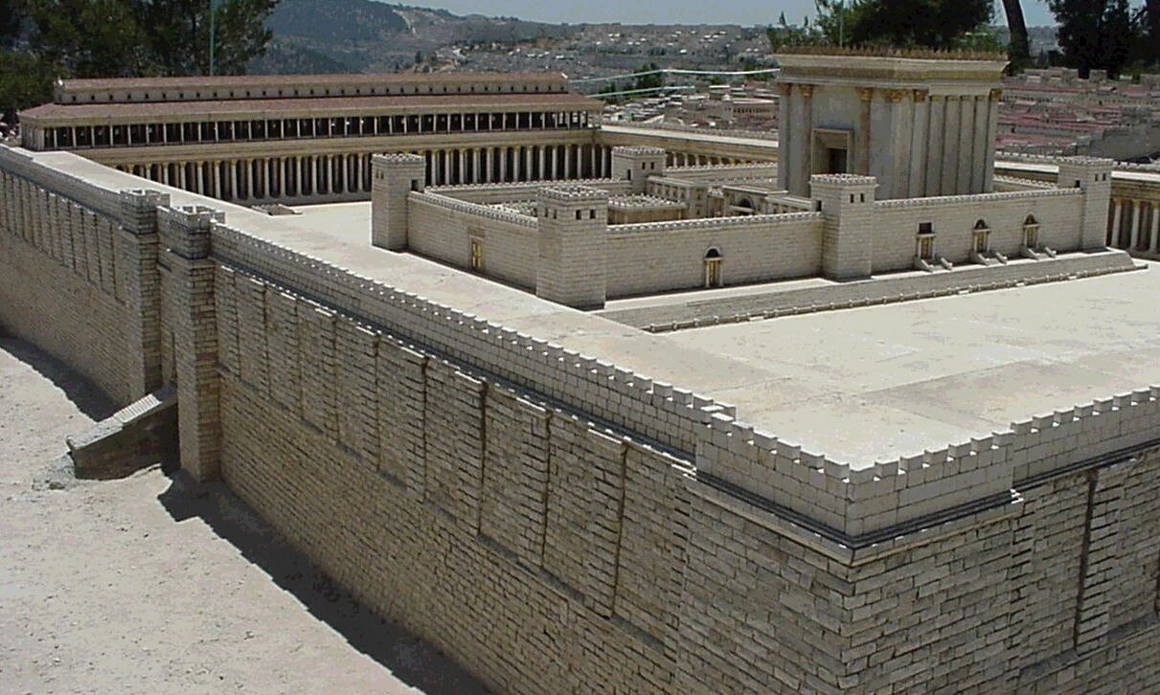

Slide 15
Four Priorities /
Distinguishing Characteristics:
The Apostle’s Teaching
Fellowship

Slide 16
acts 2:42
And they devoted themselves to the
apostles' teaching …

Slide 17
acts 2:44-45
And all who believed were together and had all things in common. And they were selling their possessions and belongings and distributing the proceeds to all, as any had need.

Slide 19
John 13:34-35
“A new commandment I give to you, that you love one another: just as I have loved you, you also are to love one another. By this all people will know that you are my disciples, if you have love for one another.”

Slide 21
Acts 2
verse 44
… they had all things in common …
verse 45
… and they were selling their possession, distributing the proceeds to any who had need …

Slide 22
Acts 4:32
Now the full number of those who believed were of one heart and soul, and no one said that any of the things that belonged to him was his own, but they had everything in common.

Slide 24
// It means moving away from this individualistic focus which is so prevalent today
// to one that is more focused on the mission, and community, and family of God.

Slide 26
Four Priorities /
Distinguishing Characteristics:
The Apostle’s Teaching
Fellowship
The Breaking of Bread

Slide 27
Acts 2:42
And they devoted themselves to the apostles' teaching and the fellowship, to the breaking of bread …

Slide 28
Acts 2:46-47
And day by day, attending the temple together and breaking bread in their homes, they received their food with glad and generous hearts, praising God and having favor with all the people.

Slide 29
// The Gospel creates a community that loves to celebrate the generosity of the Lord Jesus …
and is eager to extend that generosity to one another
and to those around them
// Would you/we be described in that way?

Slide 30
Four Priorities /
Distinguishing Characteristics:
The Apostle’s Teaching
Fellowship
The Breaking of Bread
The Prayers

Slide 31
Acts 2:42
And they devoted themselves to the apostles' teaching and the fellowship, to the breaking of bread and the prayers.

Slide 33
Acts 2:43
And awe came upon every soul, and many wonders and signs were being done through the apostles.

Slide 34
Luke 2:52
And Jesus increased in wisdom and in stature and in favor with God and man.

Slide 36
Filipino American Christian Church

