Slide 1
Filipino American Christian Church

Slide 3
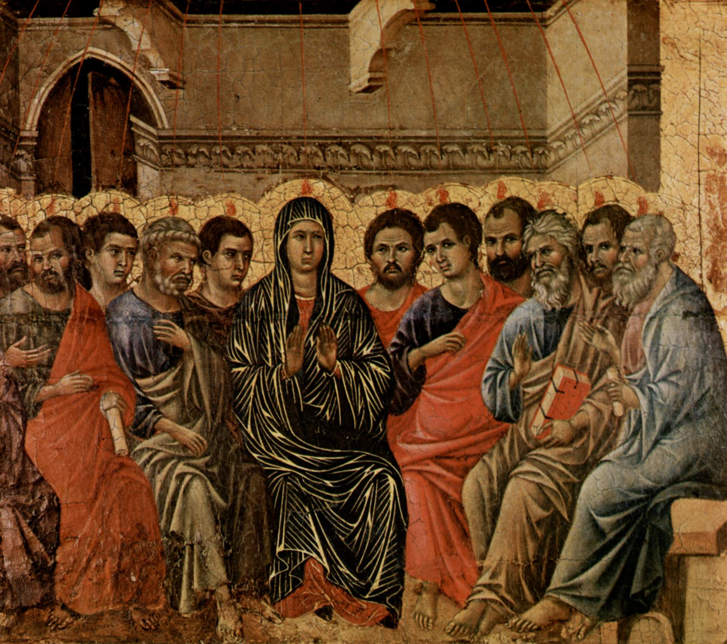

Slide 4
acts 2:1-12
When the day of Pentecost arrived, they were all together in one place. And suddenly there came from heaven a sound like a mighty rushing wind, and it filled the entire house where they were sitting. And divided tongues as of fire appeared to them and rested on each one of them. And they were all filled with the Holy Spirit and began to speak in other tongues as the Spirit gave them utterance. Now there were dwelling in Jerusalem Jews, devout men from every nation under heaven. And at this sound the multitude came together, and they were bewildered, because each one was hearing them speak in his own language.

Slide 5
acts 2:1-12
And they were amazed and astonished, saying, “Are not all these who are speaking Galileans? And how is it that we hear, each of us in his own native language? Parthians and Medes and Elamites and residents of Mesopotamia, Judea and Cappadocia, Pontus and Asia, Phrygia and Pamphylia, Egypt and the parts of Libya belonging to Cyrene, and visitors from Rome, both Jews and proselytes, Cretans and Arabians—we hear them telling in our own tongues the mighty works of God.” And all were amazed and perplexed, saying to one another, “What does this mean?”

Slide 7
John 7:37-39
“ … as the Scripture has said, ‘Out of his heart will flow rivers of living water.’”
Now this he said about the Spirit, whom those who believed in him were to receive, for as yet the Spirit had not been given, because Jesus was not yet glorified.

Slide 8
Acts 1:4-5, 8
And while staying with them he ordered them not to depart from Jerusalem, but to wait for the promise of the Father, which, he said, “you heard from me; for John baptized with water, but you will be baptized with the Holy Spirit not many days from now.” …
But you will receive power when the Holy Spirit has come upon you …

Slide 9
What does this mean?

Slide 11
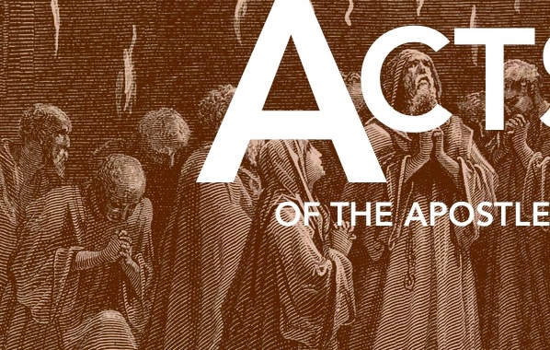
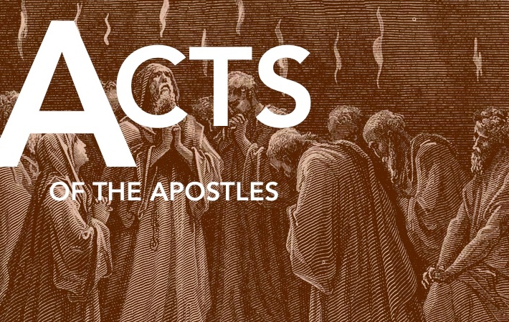
What does this mean?
FIRST: God is faithful to keep His promises.

Slide 12
Ezekiel 36:25-27
I will sprinkle clean water on you, and you shall be clean from all your uncleannesses, and from all your idols I will cleanse you. And I will give you a new heart, and a new spirit I will put within you. And I will remove the heart of stone from your flesh and give you a heart of flesh. And I will put my Spirit within you …

Slide 13
Joel 2:28-29
“And it shall come to pass afterward,
that I will pour out my Spirit on all flesh;
your sons and your daughters shall prophesy,
your old men shall dream dreams,
and your young men shall see visions.
Even on the male and female servants
in those days I will pour out my Spirit.”

Slide 14
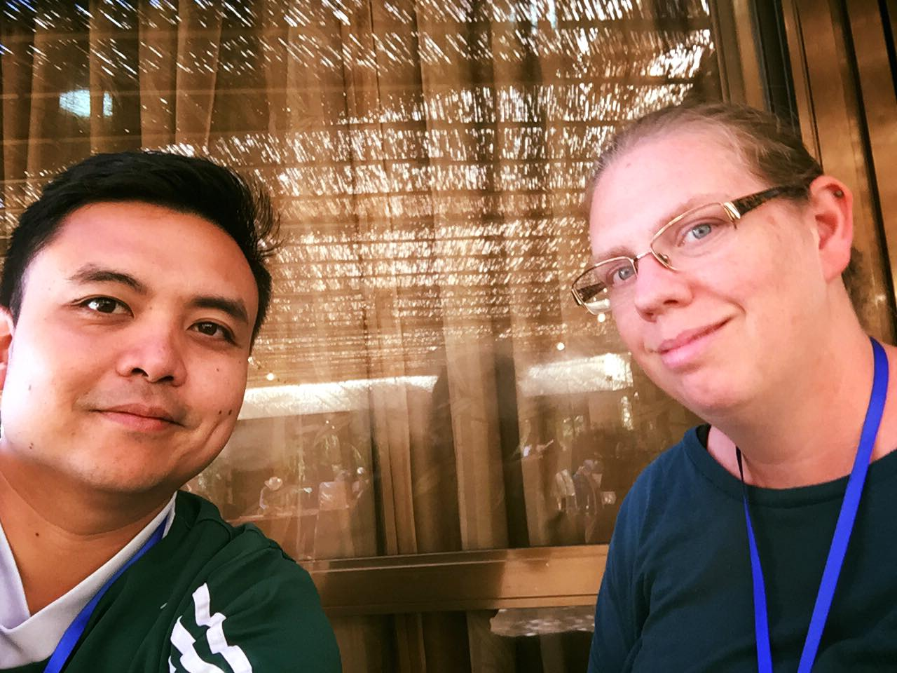

Slide 15
What does this mean?
SECOND: God desires all people to hear the good news about Jesus

Slide 17
Acts 2:4
And they were all filled with the Holy Spirit and began to speak in other tongues as the Spirit gave them utterance.

Slide 18
Acts 2:5-6
Now there were dwelling in Jerusalem Jews, devout men from every nation under heaven. And at this sound the multitude came together, and they were bewildered, because each one was hearing them speak in his own language.

Slide 19
Acts 2:7-8
And they were amazed and astonished, saying, “Are not all these who are speaking Galileans? And how is it that we hear, each of us in his own native language?”

Slide 20
Acts 2:5, 11
verse 5: Now there were dwelling in Jerusalem Jews, devout men from every nation under heaven.
verse 11: “ … both Jews and proselytes, Cretans and Arabians, we hear them telling in our own tongues the mighty works of God.”

Slide 21
Acts 2:22
“Men of Israel, hear these words: Jesus of Nazareth, a man attested to you by God with mighty works and wonders and signs that God did through him in your midst …”

Slide 22
John 20:30-31
Now Jesus did many other signs in the presence of the disciples, which are not written in this book; but these are written so that you may believe that Jesus is the Christ, the Son of God, and that by believing you may have life in his name.

Slide 23
What effect did this have on the crowd?
What effect should this have on us?

Slide 24
Acts 2
verse 6: And at this sound the multitude came together, and they were bewildered …
verse 7: And they were amazed and astonished …
verse 12: And all were amazed and perplexed …

Slide 25
Acts 2:41
verse 6: And at this sound the multitude came together, and they were bewildered …
verse 7: And they were amazed and astonished …
verse 12: And all were amazed and perplexed …

Slide 26
What does this mean?
LAST: God is building and establishing His church.

Slide 27
Acts 2:32
This Jesus God raised up, and of that we all are witnesses. Being therefore exalted at the right hand of God, and having received from the Father the promise of the Holy Spirit, he has poured out this that you yourselves are seeing and hearing.

Slide 30
Filipino American Christian Church

