Slide 1
Filipino American Christian Church

Slide 2
Judges 21:25
In those days there was no king in Israel.
Everyone did what was right in his own eyes.

Slide 3
Chapter 19: Déjà Vu
Chapter 20: Holy War (Civil War)
Chapter 21: National Crisis

Slide 4
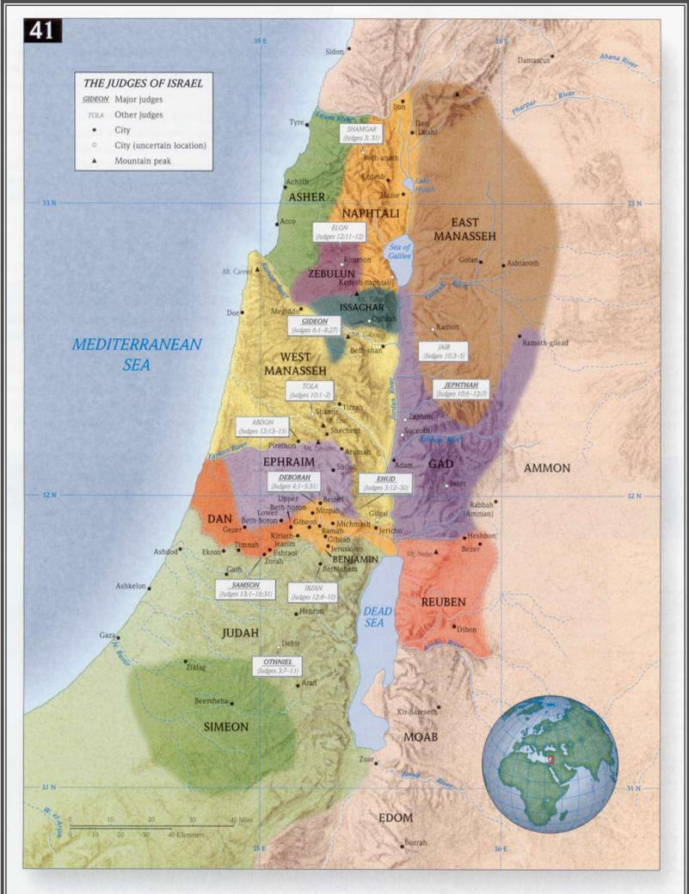
Filipino American Christian Church

Slide 5
Judges 1:21
But the people of Benjamin did not drive out the Jebusites who lived in Jerusalem, so the Jebusites have lived with the people of Benjamin in Jerusalem to this day.

Slide 6
Judges 19:20
And the old man said, “Peace be to you; I will care for all your wants. Only, do not spend the night in the square.”

Slide 7
Judges 19:22
As they were making their hearts merry, behold, the men of the city, worthless fellows, surrounded the house, beating on the door. And they said to the old man, the master of the house, “Bring out the man who came into your house, that we may know him …”

Slide 8
Filipino American Christian Church

Slide 9
Judges 19:27-28
And her master rose up in the morning, and when he opened the doors of the house and went out to go on his way, behold, there was his concubine lying at the door of the house, with her hands on the threshold. He said to her, “Get up, let us be going.” But there was no answer. Then he put her on the donkey, and the man rose up and went away to his home.

Slide 10
Judges 19:30
And all who saw it said, “Such a thing has never happened or been seen from the day that the people of Israel came up out of the land of Egypt until this day; consider it, take counsel, and speak.”

Slide 11
Filipino American Christian Church

Slide 12
Chapter 19: Déjà Vu
Chapter 20: Holy War (Civil War)
Chapter 21: National Crisis

Slide 13
Judges 20:3
(Now the people of Benjamin heard that the people of Israel had gone up to Mizpah.) And the people of Israel said, “Tell us, how did this evil happen?”

Slide 14
Judges 20:4-7
And the Levite, the husband of the woman who was murdered, answered and said, “I came to Gibeah that belongs to Benjamin, I and my concubine, to spend the night. And the leaders of Gibeah rose against me and surrounded the house against me by night. They meant to kill me, and they violated my concubine, and she is dead. So I took hold of my concubine and cut her in pieces and sent her throughout all the country of the inheritance of Israel, for they have committed abomination and outrage in Israel. Behold, you people of Israel, all of you, give your advice and counsel here.”

Slide 15
Filipino American Christian Church

Slide 16
Judges 20:28
… and Phinehas the son of Eleazar, son of Aaron, ministered before it in those days), saying, “Shall we go out once more to battle against our brothers, the people of Benjamin, or shall we cease?” And the Lord said, “Go up, for tomorrow I will give them into your hand.”

Slide 17
Filipino American Christian Church

Slide 18
Judges 21:25
In those days there was no king in Israel.
Everyone did what was right in his own eyes.

Slide 19
Filipino American Christian Church

Slide 20
Chapter 19: Déjà Vu
Chapter 20: Holy War (Civil War)
Chapter 21: National Crisis (and Canaanite solutions)

Slide 21
Judges 21:1
Now the men of Israel had sworn at Mizpah, “No one of us shall give his daughter in marriage to Benjamin.”

Slide 22
Judges 21:12
And they found among the inhabitants of Jabesh-gilead 400 young virgins who had not known a man by lying with him, and they brought them to the camp at Shiloh, which is in the land of Canaan.

Slide 23
Filipino American Christian Church

Slide 24
Judges 21:20-22
And they commanded the people of Benjamin, saying, “Go and lie in ambush in the vineyards and watch. If the daughters of Shiloh come out to dance in the dances, then come out of the vineyards and snatch each man his wife from the daughters of Shiloh, and go to the land of Benjamin. And when their fathers or their brothers come to complain to us, we will say to them, ‘Grant them graciously to us, because we did not take for each man of them his wife in battle, neither did you give them to them, else you would now be guilty.’”

Slide 25
Filipino American Christian Church

Slide 26
Judges 21:25
In those days there was no king in Israel.
Everyone did what was right in his own eyes.

Slide 27
Filipino American Christian Church

Slide 28
Judges 21:25
In those days there was no king in Israel.
Everyone did what was right in his own eyes.

Slide 29
Deuteronomy 17:14-20
“When you come to the land that the Lord your God is giving you, and you possess it and dwell in it and then say, ‘I will set a king over me, like all the nations that are around me,’ you may indeed set a king over you whom the Lord your God will choose. One from among your brothers you shall set as king over you. You may not put a foreigner over you, who is not your brother. Only he must not acquire many horses for himself or cause the people to return to Egypt in order to acquire many horses, since the Lord has said to you, ‘You shall never return that way again.’ And he shall not acquire many wives for himself, lest his heart turn away, nor shall he acquire for himself excessive silver and gold.

Slide 30
Deuteronomy 17:14-20
“And when he sits on the throne of his kingdom, he shall write for himself in a book a copy of this law, approved by the Levitical priests. And it shall be with him, and he shall read in it all the days of his life, that he may learn to fear the Lord his God by keeping all the words of this law and these statutes, and doing them, that his heart may not be lifted up above his brothers, and that he may not turn aside from the commandment, either to the right hand or to the left, so that he may continue long in his kingdom, he and his children, in Israel.”

Slide 31
Filipino American Christian Church

