Slide 1
Filipino American Christian Church

Slide 2
Filipino American Christian Church

Slide 3
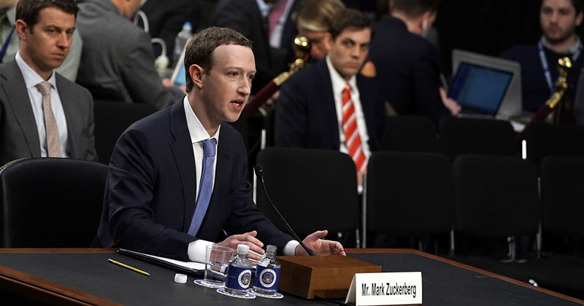
Filipino American Christian Church

Slide 4
Filipino American Christian Church

Slide 5
Embracing suffering and humiliation is a way of identifying with Jesus Christ and participating in His redemptive mission
and this will very likely, and can very often, appear foolish and naïve from the perspective of the world.

Slide 6
Filipino American Christian Church

Slide 7
Acts 24:25-27
And as he reasoned about righteousness and self-control and the coming judgment, Felix was alarmed and said, “Go away for the present. When I get an opportunity I will summon you.” At the same time he hoped that money would be given him by Paul. So he sent for him often and conversed with him. When two years had elapsed, Felix was succeeded by Porcius Festus. And desiring to do the Jews a favor, Felix left Paul in prison.

Slide 8
Acts 24:22-25
But Felix, having a rather accurate knowledge of the Way, put them off, saying, “When Lysias the tribune comes down, I will decide your case.” Then he gave orders to the centurion that he should be kept in custody but have some liberty, and that none of his friends should be prevented from attending to his needs.
After some days Felix came with his wife Drusilla, who was Jewish, and he sent for Paul and heard him speak about faith in Christ Jesus. And as he reasoned about righteousness and self-control and the coming judgment, Felix was alarmed and said, “Go away for the present. When I get an opportunity I will summon you.”

Slide 9
Acts 24:25-27
And as he reasoned about righteousness and self-control and the coming judgment, Felix was alarmed and said, “Go away for the present. When I get an opportunity I will summon you.” At the same time he hoped that money would be given him by Paul. So he sent for him often and conversed with him. When two years had elapsed, Felix was succeeded by Porcius Festus. And desiring to do the Jews a favor, Felix left Paul in prison.

Slide 10
Filipino American Christian Church

Slide 11
Acts 25:8
Paul argued in his defense, “Neither against the law of the Jews, nor against the temple, nor against Caesar have I committed any offense.”

Slide 12
Filipino American Christian Church

Slide 13
Acts 23:11
The following night the Lord stood by him and said, “Take courage, for as you have testified to the facts about me in Jerusalem, so you must testify also in Rome.”

Slide 14
Filipino American Christian Church

Slide 15
Acts 25:26
But I have nothing definite to write to my lord about him. Therefore I have brought him before you all, and especially before you, King Agrippa, so that, after we have examined him, I may have something to write.

Slide 16
Filipino American Christian Church

Slide 17
Galatians 1:14
And I was advancing in Judaism beyond many of my own age among my people, so extremely zealous was I for the traditions of my fathers.

Slide 18
Filipino American Christian Church

Slide 19
And I punished them often in all the synagogues and tried to make them blaspheme, and in raging fury against them I persecuted them even to foreign cities.
-ACTS 26:11
For you have heard of my former life in Judaism, how I persecuted the church of God violently and tried to destroy it.
-GALATIANS 1:13

Slide 20
Filipino American Christian Church

Slide 21
Galatians 1:12
For I did not receive it from any man, nor was I taught it, but I received it through a revelation of Jesus Christ.

Slide 22
Filipino American Christian Church

Slide 23
Acts 26:18
… to open their eyes, so that they may turn from darkness to light and from the power of Satan to God, that they may receive forgiveness of sins and a place among those who are sanctified by faith in me.’

Slide 24
Filipino American Christian Church

Slide 25
When he had arrived, the Jews who had come down from Jerusalem stood around him, bringing many and serious charges against him that they could not prove. They brought many charges against Paul that they cannot prove.
-Acts 25:7
When the accusers stood up, they brought no charge in his case of such evils as I supposed.
-Acts 25:18

Slide 26
But I found that he had done nothing deserving death. And as he himself appealed to the emperor, I decided to go ahead and send him. But I have nothing definite to write to my lord about him.
-Acts 25:25-26
And when they had withdrawn, they said to one another, “This man is doing nothing to deserve death or imprisonment.” And Agrippa said to Festus, “This man could have been set free if he had not appealed to Caesar.”
-Acts 26:31-32

Slide 27
Filipino American Christian Church

Slide 28
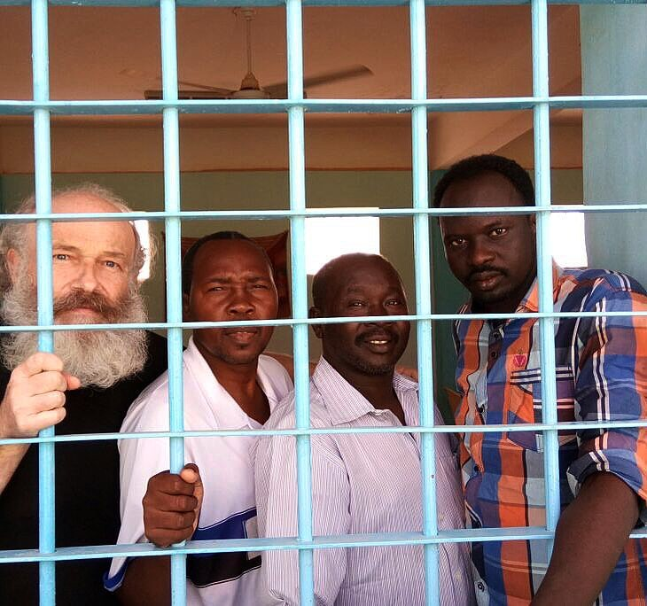
Filipino American Christian Church

Slide 29
Filipino American Christian Church

